Slide 1
Xuanying Shen, Gareth Morris, Yunyi Zhou, Yaohui Liang
Chinese Language Learning Strategies and Motivation

Slide 2
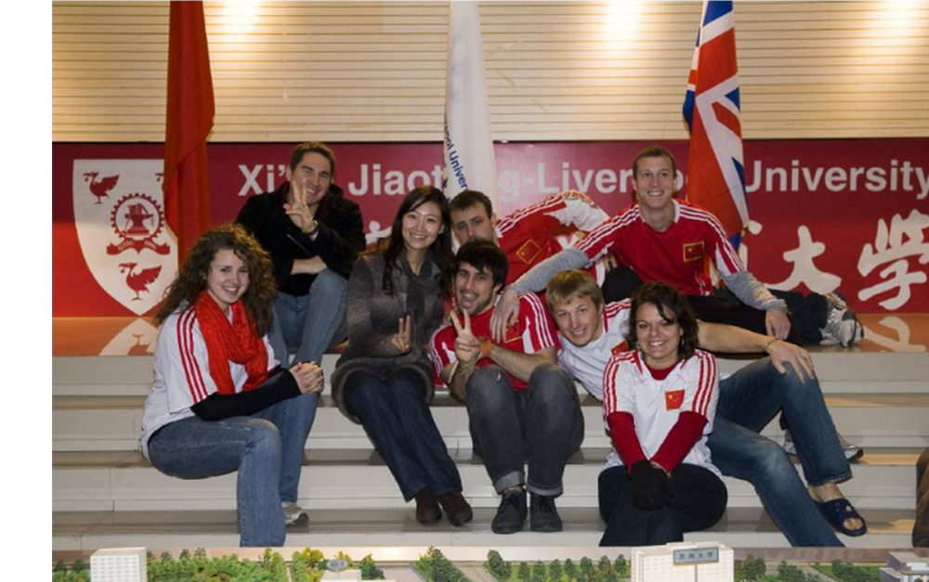
Research Rationale
Pedagogic Commitment
Improvement of Chinese Language Teaching Team (CLTT) programme offerings
Increasing number and scope of CLTT modules
Increasing number and diversity of learners
Professional and Research Opportunity
Professional development of staff
Literature gap vs. English language learning motivation in China (Gao et al., 2004), and into Chinese language learning strategies given growing importance of the language (Chen, 2008)
AILA Commitment

Slide 3
Strategy Focus Rationale
This is an essential component in the language learning process (Hong-Nam and Leavell, 2007)
Knowledge of learner strategies can play an important role in improving the teaching quality. This is because student habits, preferences and needs can be better considered, and viewed alongside achievement may highlight where changes could be made
Knowledge of strategy use may also indicate where too much / little time is being spent in-class (if in-class language learning strategies are considered independently)
Knowledge can also help to improve the learning process, as well as enhance self awareness

Slide 4
Motivation Focus Rationale
There is a relationship between language competence, academic achievement and subsequently future employment (especially in an English medium university)
Motivation is regarded as the driving force behind why, with what amount of effort and for how long a language is learnt (Dörnyei, 1998, 2001; Gardner 2001)
Motives are affected by the context (Gardner and Lambert, 1972)
Motives are also temporal (Dörnyei and Otto, 1998)
Knowing what motivates students has implications for curriculum / syllabus design, student satisfaction and course effectiveness

Slide 5
Research Questions
Research Question 1
What Chinese language learning strategies do adult learners’ use?
Research Question 2 (a and b)
Does the linguistic background of adult learners’ influence the language learning strategies they use?
Does the language proficiency of adult learners’ influence the language learning strategies they use?
Research Question 3 (a and b)
What motivated the learners to study Chinese?
What currently motivates the learners to study Chinese?

Slide 6
Methodology
Participants and Site: 63 language learners studying / working at XJTLU
30 staff / expatriate residents and 33 institutional / visiting students
Research Instrument: Questionnaire
Adapted from Oxford’s (1990) Strategy Inventory of Language Learning (SILL)
Data Collection: In person, via colleagues
Ethical Commitments: Aligned to XJTLU’s and BERA (British Education Research Association)
(e.g. Informed consent, anonymity, safeguard participant wellbeing)
Data Analysis: Descriptive

Slide 7
Chinese Language Learning Strategies

Slide 8
Research Question 1
What Chinese language learning strategies do adult learners’ use?
Strategy | Mean (Standard Deviation)
Social Strategy | 3.57 (1.05)
Compensation Strategy | 3.30 (1.18)
Metacognitive Strategy | 3.13 (1.72)
Cognitive Strategy | 3.10 (1.20)
Memory Strategy | 2.84 (1.20)
Affective Strategy | 2.69 (1.28)
 | (N = 63)
Social strategies: learning with others
Compensation strategies: using the language despite lacking knowledge
Metacognitive strategies: coordinating the learning process
Cognitive strategies: understanding and producing the language
Memory strategies: remembering and retrieving new information
Affective strategies: regulating emotions
5 = Almost Always True
4 = Usually True
3 = Somewhat True
2 = Usually Not True
1 = Rarely, If Ever, True

Slide 9
Research Question 2a (All)
Does the linguistic background of adult learners’ influence the language learning strategies they use?
Strategy | Indo-European | Sino-Tibetan | Austronesian | Semito-Hamitic | All
Social Strategy | 3.55 (1.08) | 4.33 (1.00) | 3.39 (0.69) | 3.61 (1.33) | 3.57 (1.05)
Compensation Strategy | 3.21 (1.19) | 3.62 (1.40) | 3.50 (0.91) | 3.17 (1.77) | 3.30 (1.18)
Metacognitive Strategy | 3.08 (1.16) | 3.56 (1.18) | 3.07 (0.83) | 3.13 (1.42) | 3.13 (1.72)
Cognitive Strategy | 3.00 (1.21) | 3.26 (1.25) | 3.00 (0.99) | 2.83 (1.52) | 3.10 (1.20)
Memory Strategy | 2.80 (1.25) | 3.22 (1.14) | 2.82 (0.99) | 3.22 (1.12) | 2.84 (1.20)
Affective Strategy | 2.65 (1.28) | 2.60 (1.25) | 2.77 (1.14) | 2.85 (1.76) | 2.69 (1.28)
 | (N = 45) | (N = 4) | (N = 11) | (N = 3) | (N = 63)
Indo-European Family (English, French, German, Denmark, Spanish, Italian, Icelandic, Greek, Hindi, Urdu)
Sino-Tibetan Family (Korean, Nepalese, Burmese)
Austronesian Family (Indonesian, Bahasa, Jawi)
Semito-Hamitic Family (Arabic, Akan, Swahili)

Slide 10
Research Question 2b (Students)
Does the language proficiency of adult learners’ influence the language learning strategies they use?
Strategy | Beginner | Intermediate | Advanced | All Students | All Adults
Social Strategy | 3.56 (0.93) | 4.06 (0.89) | 3.73 (0.93) | 3.68 (0.94) | 3.57 (1.05)
Compensation Strategy | 3.36 (1.12) | 3.64 (0.98) | 3.70 (0.90) | 3.64 (1.07) | 3.30 (1.18)
Metacognitive Strategy | 3.29 (1.00) | 3.33 (1.09) | 3.50 (0.74) | 3.31 (0.98) | 3.13 (1.72)
Cognitive Strategy | 2.98 (1.17) | 3.18 (1.18) | 3.43 (0.99) | 3.08 (1.16) | 3.10 (1.20)
Memory Strategy | 2.91 (1.15) | 3.06 (1.16) | 2.82 (1.06) | 2.93 (1.14) | 2.84 (1.20)
Affective Strategy | 2.87 (1.29) | 2.79 (1.30) | 2.71 (0.94) | 2.83 (1.25) | 2.69 (1.28)
 | (N = 22) | (N = 6) | (N = 5) | (N = 33) | (N = 63)

Slide 11
Research Question 2b (Staff)
Does the language proficiency of adult learners’ influence the language learning strategies they use?
Strategy | Beginner | Higher Beginner | Intermediate | All Staff | All Adults
Social Strategy | 3.42 (1.09) | 3.55 (0.93) | 3.23 (1.20) | 3.39 (1.14) | 3.57 (1.05)
Compensation Strategy | 2.96 (1.35) | 3.27 (1.15) | 3.28 (1.25) | 3.14 (1.28) | 3.30 (1.18)
Metacognitive Strategy | 3.04 (1.20) | 3.02 (1.20) | 2.65 (1.21) | 2.90 (1.21) | 3.13 (1.72)
Cognitive Strategy | 2.71 (1.29) | 2.96 (1.11) | 3.04 (1.29) | 2.90 (1.25) | 3.10 (1.20)
Memory Strategy | 2.80 (1.23) | 2.97 (1.23) | 2.56 (1.30) | 2.76 (1.26) | 2.84 (1.20)
Affective Strategy | 2.52 (1.27) | 2.51 (1.46) | 2.51 (1.25) | 2.51 (1.31) | 2.69 (1.28)
 | (N = 13) | (N = 7) | (N = 10) | (N = 30) | (N = 63)

Slide 12
Chinese Language Learning Motivation

Slide 13
Research Question 3a and b
What motivated / currently motivates the learners to study Chinese?
Initial Motive All | Percentage (N) All |  | Present Motive All | Percentage (N) All
Business Employment | 25% (16) |  | Communication (Desire) | 19% (12)
Adaption Survival | 22% (14) |  | Nothing | 17% (11)
Language Culture Interest | 21% (13) |  | Business Employment | 14% (9)
Other People | 14% (9) |  | Language Culture Interest | 14% (9)
Nothing | 8% (5) |  | Location (Opportunity) | 11% (7)
Communication (Desire) | 6% (4) |  | Other People | 10% (6)
Travel | 2% (1) |  | Adaption Survival | 10% (6)
Self - Improvement | 2% (1) |  | Self – Improvement | 3% (2)
 |  |  | Travel | 2% (1)

Slide 14
Research Question 3a and b (Students)
Initial Motives | Percentage (Number) | Present Motives | Percentage (Number)
Business Employment | 40% (13) | Business Employment | 24% (8)
Language Culture Interest | 21% (7) | Nothing | 21% (7)
Adaption Survival | 12% (4) | Language Culture Interest | 15% (5)
Other People | 12% (4) | Communication (Desire) | 15% (5)
Nothing | 12% (4) | Other People | 9.5% (3)
Communication (Desire) | 3% (1) | Location (Opportunity) | 9.5% (3)
 |  | Adaption Survival | 6% (2)

Slide 15
Research Question 3a and b (Staff)
Initial Motives | Percentage (Number) | Present Motives | Percentage (Number)
Adaption Survival | 34% (10) | Communication (Desire) | 23% (7)
Language Culture Interest | 20% (6) | Adaption Survival | 13.5% (4)
Other People | 17% (5) | Language Culture Interest | 13.5% (4)
Communication (Desire) | 10% (3) | Location (Opportunity) | 13.5% (4)
Business Employment | 10% (3) | Nothing | 13.5% (4)
Travel | 3% (1) | Other People | 10% (3)
Self - Improvement | 3% (1) | Self - Improvement | 7% (2)
Nothing | 3% (1) | Business Employment | 3% (1)
 |  | . Travel . | 3% (1)

Slide 16
Summary
Strategy Use
Adult learners seem to apply a number of language learning strategies in order to learn Chinese
Based on the learners’ linguistic background, a reasonably stable rank order appeared to be in evidence, regarding the language learning strategies they used
This same rank order was also in evidence regardless of the language proficiency of the students, although in the staff group, notable difference appears with regard to different language proficiency.
When staff and students have similar language proficiency, staff tended to use less strategies than students when learning Chinese. They also did so to a lesser extent
Motivation
The initial and present motivation of learners has evolved. More motives have emerged
The relative prominence of the motives has changed and appears to be influenced by context and needs

Slide 17
References
Chen, Y. (2009). A Ten Year Review of Studies on Chinese Second Language Learning Strategies. Chinese Study Journal, 6, 153-157.
Dörnyei, Z. (1998).Motivation in Second and Foreign Language Learning. Language Teaching, 31(3), 117-135.
Dörnyei, Z. (2001). Teaching and Researching Motivation. Harlow: Longman.
Dörnyei, Z. Otto, I. Motivation in Action: A Process Model of L2 Motivation. Working Papers in Applied Linguistics (Thames Valley University), 4, 43-69.
Gao, Y. et al. (2004). Motivation Types of English Learning among Chinese University Undergraduates. Asian Journal of English Language Teaching, 14, 45-64.
Gardner, R. (2001). Language Learning Motivation: The Student, the Teacher and the Researcher. Texas Papers in Foreign Language Education, 6(1), 1-18.
Gardner, R. Lambert, W. (1972). Attitudes and Motivation in Second Language Learning. Newbury House: Rowley, MA.
Hong-Nam, K. Leavell, A. G. (2007). A Comparative Study of Language Learning Strategy Use in an EFL Context: Monolingual Korean and Bilingual Korean - Chinese University Students. Asia Pacific Education Review, 8 (1), 71-88.
Oxford, R. L. (1990). Language Learning Strategies: What Every Teacher Should Know. Boston: Heinle and Heinle.
Pan, L. Seargeant, P. (2012). Is English Threatening Chinese Language and Culture? English Today. 28 (3), 60-66.

Slide 18
Thank You
xuanying.shen@xjtlu.edu.cn gareth.morris@xjtlu.edu.cn
yunyi.zhou@xtjlu.edu.cn yaohui.liang@xjtlu.edu.cn

