Slide 1
Applying Service Learning in a Chinese University
Dr. Bo Wu
Lecturer, Dept. of Public Health
Xi’an Jiaotong Liverpool University
April 7, 2016

Slide 2
Map
What is service learning?
How is service learning different from other community-based activities?
How to transform a regular course to service-learning?
My previous experiences on service learning in a Chinese university
Pros and cons of service learning
Institutional support to service learning

Slide 3
Service Learning
Service learning is a credit-bearing educational experience in which students participate in an organized service activity that meets identified community needs, and reflect on the service in a way to gain further understanding of course content, a broader appreciation of the discipline, and an enhanced sense of civic (social) responsibility.
Bringle & Hatcher, 1996, p. 222

Slide 4
Service-Learning is a teaching and learning strategy that integrates meaningful community service with instruction and reflection to enrich the learning experience, teach civic (social) responsibility, and strengthen communities.
http://www.servicelearning.org/what-service-learning

Slide 5
Service-learning
Service-learning is a form of experiential education that allows students to learn by doing.
Time spent working with a community-based organization becomes part of the students' homework. The community serves as a "lived text"—another powerful source of information to complement course readings, lectures, and discussions.
Service-learning include reflections. Reflection helps students articulate what they've learned in the community, and connect that to their classroom studies.
http://www.servicelearning.umn.edu/info/whatis.html

Slide 6
Service-learning can be applied in a wide variety of settings, including schools, universities, and community-based organizations.
It can involve a group of students, a classroom or an entire school.
http://www.servicelearning.org

Slide 7
STUDENTS can benefit academically, professionally, and personally.
Gain hands-on experience (possibly leading to an internship or job)
Explore individuals’ values
Develop critical thinking and problem-solving skills
Grow understanding of diverse cultures / communities
Learn more about social issues and the root causes
Improve the ability to handle ambiguity and be open to change
Enhance certain skills, especially in communication, collaboration, and leadership
Test out the skills, interests, and values in a potential career path
Connect with professionals and/or community members who you will learn from
Grow a professional network of people you might connect with later for jobs or internships
Motivate the interests for public service or civic engagement

Slide 8
FACULTY can benefit personally and professionally
Encourage interactive teaching and reciprocal learning between students and faculty
Promote students' active learning
Add new insights to class discussions
Lead to new avenues to research and publication
Help students achieve learning and development outcomes
Develop students' social responsibility and leadership skills
Provide networking with engaged faculty in other disciplines
Foster relationships between faculty and community organizations, which can open other opportunities for collaborative work
Provide firsthand knowledge of community issues; provide opportunities to be more involved in community issues
Boost course enrollment by attracting highly motivated students

Slide 9
COMMUNITY PARTNERS can benefit
Gain additional human resources to achieve organizational goals
Inject new energy, enthusiasm, and perspectives into the organization's work
Increase public awareness of key issues
Reach out to youth—an important part of organization's future support
Educate students about community issues; correct misperceptions
Network with colleagues in other organizations and agencies
Identify and access university resources
build relationships with faculty, students, and staff
Help prepare students to be tomorrow's civic leaders
Grow organization's volunteer pool: students and friends

Slide 10
Undergraduate students’ learning outcomes (University of Minnesota)
identify, define, and solve problems
locate and critically evaluate information
mastered a body of knowledge and a mode of inquiry
Understand diverse philosophies and cultures within and across societies
communicate effectively
understand the role of creativity, innovation, discovery, and expression across disciplines
acquire skills for effective citizenship and life-long learning

Slide 11
The Experiential Learning Continuum
Service Learning
Community Service
Field Education
Volunteerism
Internship/ Co-op/Practicum
Furco, A. (1996). Service-learning: A balanced approach to experiential education. In Corporation for National Service (Ed.), Expanding Boundaries: Serving and Learning (pp. 2-6). Columbia, MD: Cooperative Education Association.
Retrieved from: http://www.apa.org/ed/slce/definitions.html

Slide 12
Service-learning aligns with David Kolb’s model of experiential learning cycle
http://www.servicelearning.umn.edu/info/reflection.html

Slide 13
Transform a course
to service learning

Slide 14
Learning outcomes
Example 1: (Accounting) Students will be able to identify and demonstrate basic principles and practices of accounting.
Example 2: (Education) Students will be able to describe and provide examples appropriate learning activities for different developmental stages.

Slide 15
Service goals
Example 1: (Accounting) Provide community members one-on-one assistance with the tax preparation.
Example 2: (Education) Provide tutoring support for an after school program for elementary school students.

Slide 16
Service Learning Objectives
Example 1: Accounting students will demonstrate their knowledge and skills of using basic principles and practices of accounting by assisting community members with one-on-one preparation of their tax forms.
Example 2: Education students will learn about the developmental stages of children by observing and reflecting upon their activities while tutoring elementary school students in an after school program.

Slide 17
Academic Materials
Relevant
Community services
Relevant
Critical reflections
(Eyler & Giles, 1999)

Slide 18
Teaching goals
Individual growth: critical reflection improves individual growth, such as recognizing one’s strength, weakness, talents, skills, etc., and what kind of person one wants to be (value).
Civic learning: it helps one learns how individuals and team interact and how interaction facilitates team change or institutional change. In other words, how changes happen.
Academic improvement: help students understand the course content better in the community setting. Through critical reflection, students know how to apply knowledge in the real world. For example, is the knowledge learned at classroom consistent with my experiences in the community? What are the differences? What are the challenges when applying knowledge in the real world?
(Ash, Clayton, & Moses, 2009)

Slide 19
Conditions
Institutional support to service learning
Community partnership and rapport

Slide 20
My experimental experiences on service learning in a Chinese university
A teaching university; tier 2
Dept. of Family Science (human services) in School of Education
Located in Guangdong, next to Shenzhen, Macau
22,000 in total; 99% undergraduate, 75% from Guangdong
Size: 40-80 students per class
Lacking institutional support
Difficult to find local community partners that are able to support service learning

Slide 21
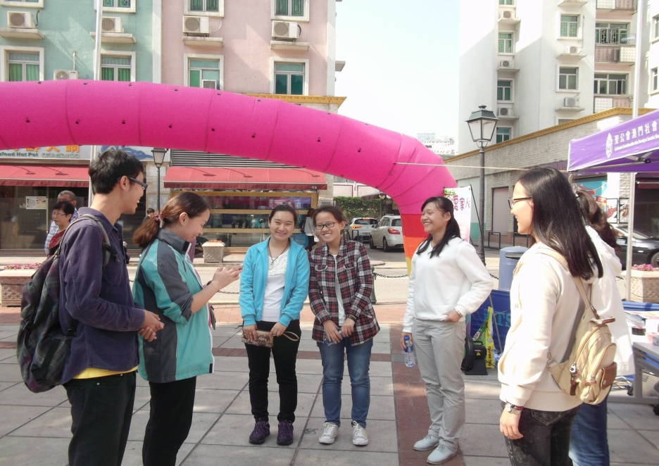
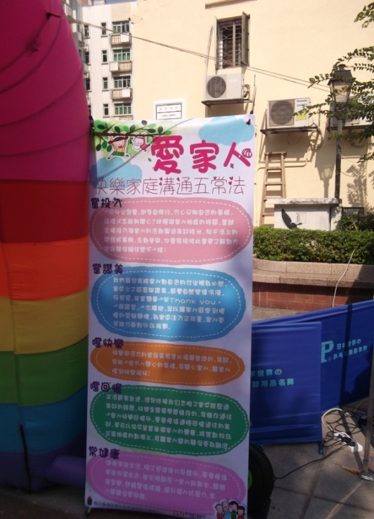
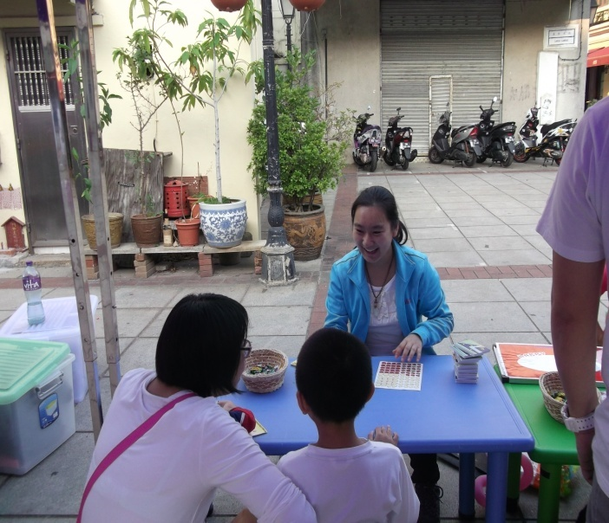
Child Deployment in the Context
Service-learning objectives:
Students will learn about the developmental stages of children and parent-child interactions by volunteering a program of “Family Day” for a nonprofit organization in Macau and reflecting upon their activities.

Slide 22
Community Psychology
Service-learning objectives
Through one semester’s learning, students should be able to
understand the definition of community;
critically reflect upon their understanding of the knowledge and the misconception of the real world;
connect the concepts learned in the classroom to the real world challenges;
provide suggestions to community needs or provide support

Slide 23
Community Psychology
Homework for students:
1. Class report of the progress (3 times a semester)
2. Presentation (a pair each week, for 4 weeks)
3. Final paper: making the connections between the theories or concepts with the individual community experiences (4)
4. Final paper mark: peer review score is included(10%-15% as the individual contribution to the group work)

Slide 24
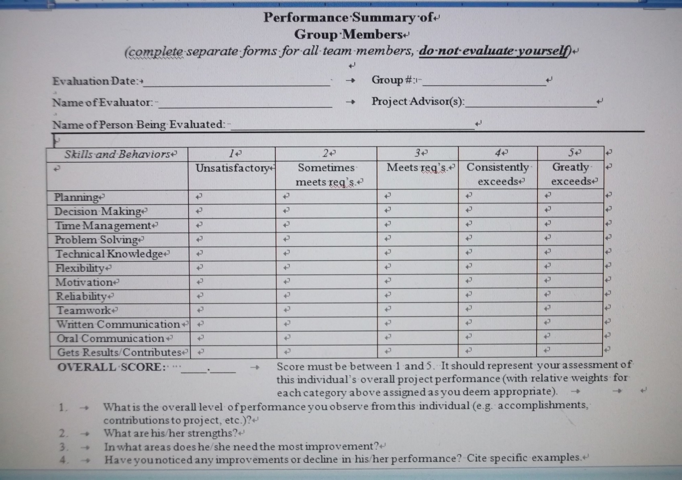
Community Psychology
From Center of Service and Learning, IUPUI

Slide 25
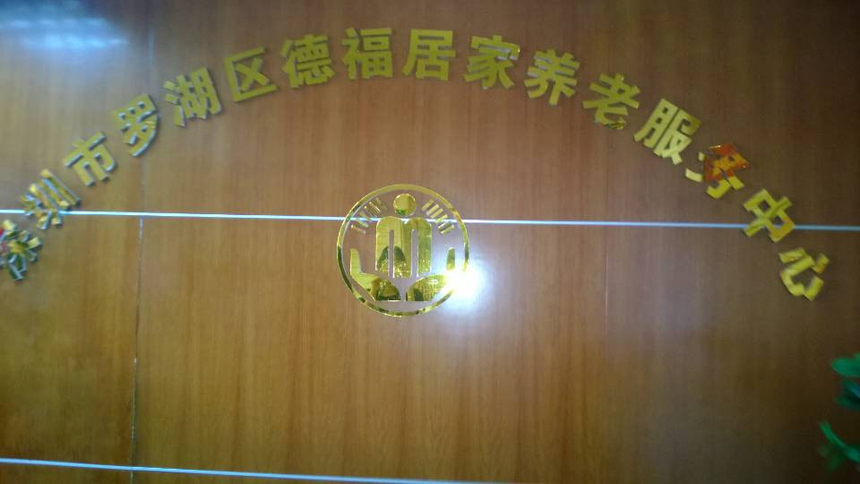
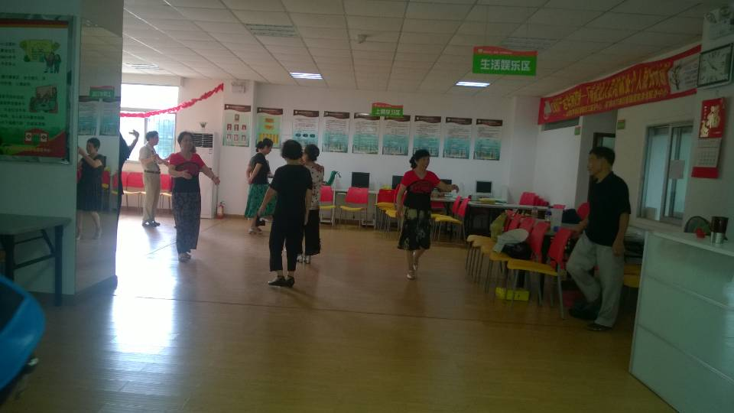
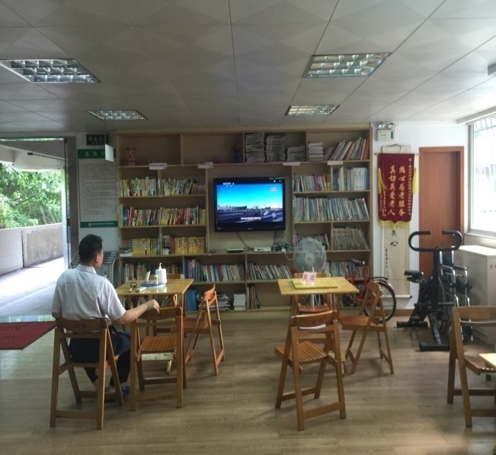
Students visit a community center for local elders in Shenzhen. They are asked to connect knowledge from Community Psychology to this field trip.

Slide 26
I share students’ reflection papers (78 students) to the community center for elders in Shenzhen. The community partner says it helps them a lot to generate new ideas for the future development and they are excited to see students’ passion for social services.
“吴老师：我仔细阅读了学生们的参观感受。我看到同学们对社区养老、居家养老有了全新的理解. 有同学还对家人和自己所住社区的养老前景有了憧憬。最令我欣赏的是大家从不同角度分析，如对深圳非户籍老人的养老需求、非盈利机构对政府资金的依赖等。最惊喜莫过于有的同学更坚定了服务社区的信念。对我们而言这些弥足珍贵。感谢吴老师帮忙收集这些感想！ 深圳德福居家养老中心 戴玉”

Slide 27
Take Home Messages
1. As one of pedagogies, service learning has its underpinning model, which is still under debate in academia (intellectual vs. practical).
2. It facilities individual growth for both affective and cognitive dimensions among students through a process.
3. It requires institutional support to encourage more faculties transform their teaching, including promotion criteria, technical support, funding, time, as well as students’ understanding, etc.
4. Whether adopt service learning or not depends on the chosen learning outcomes at university level and program level.

Slide 28
Questions, comments, suggestions?
Dr. Bo (Pearl) Wu
Lecturer
Department of Public Health, XJTLU
Bo.Wu@xjtlu.edu.cn

