Slide 1
Towards Impact ⁺ University: Looking Ahead to Sustainability Education at XJTLU in 2025
2016 XJTLU Learning and Teaching Colloquium Imagining the Next 10 Years in Learning and Teaching
April 7, 2016

Slide 2
Outline
Why should we care about sustainability education
Looking outside
Looking inside
Looking into future

Slide 3
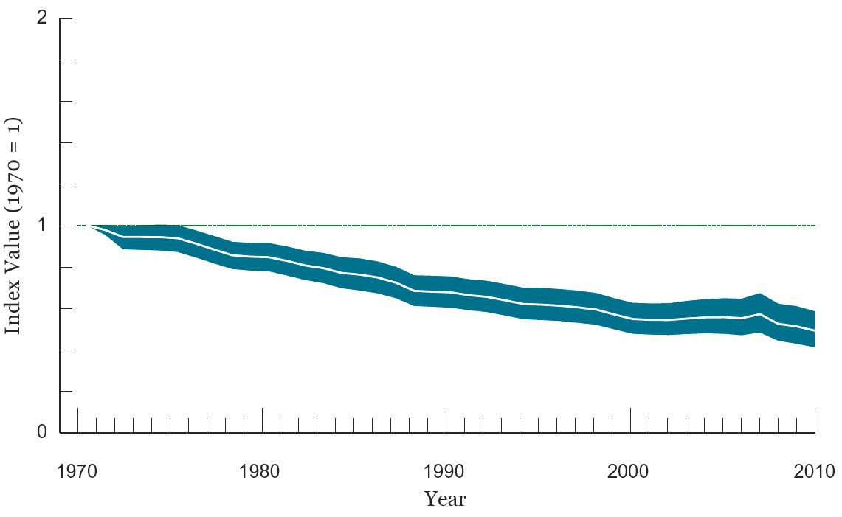
Living Planet Index (LPI)
The global LPI shows a 52% decline between 1970 and 2010.
Notes:
This means that animal populations are roughly half the size they were in 40 years ago.

Slide 4
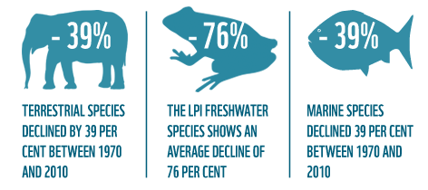

Slide 5
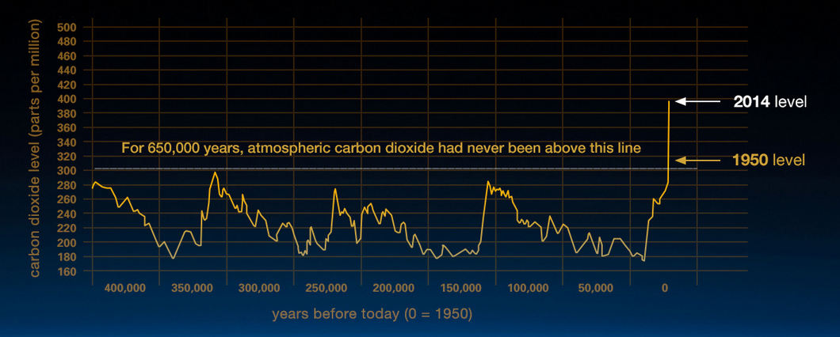
Climate change and Global warming
Source: NASA, 2014
Notes:
http://climate.nasa.gov/evidence/

Slide 6
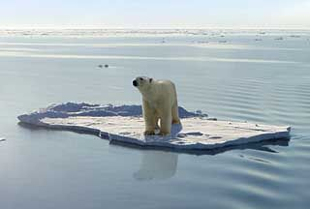
PressTV 2010
Scientists call event “tipping point" in global warming
-National Sea Ice and Data Center (09/16/12)
Notes:
Arctic sea ice drops to its lowest level since modern recording began

Slide 7
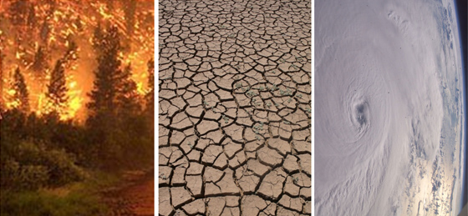
Taken as a whole, the range of published evidence indicates that the net damage costs of climate change are likely to be significant and to increase over time.
- Intergovernmental Panel on Climate Change
Notes:
The potential future effects of global climate change include more frequent wildfires, longer periods of drought in some regions and an increase in the number, duration and intensity of tropical storms.

Slide 8
？
What kind of world do we want for the future, within the limits of our Earth’s life support systems?
How are the problems of our world interconnected, and what does that imply for their solution?
How well our programs are preparing students for social and environmental stewardship?
Notes:
How can we better understand the complexity of the world around us?

Slide 9
UN Sustainable Development Goals (SDG)

Slide 10
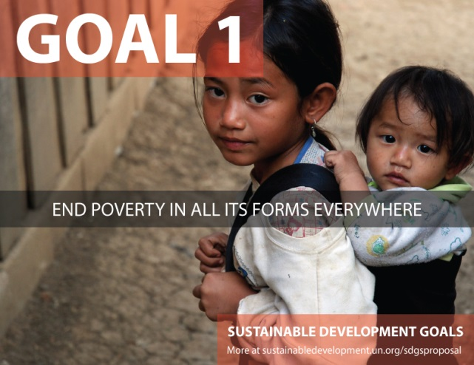
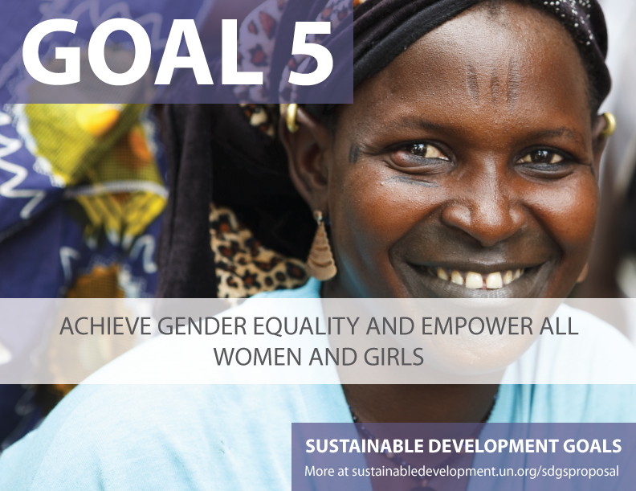
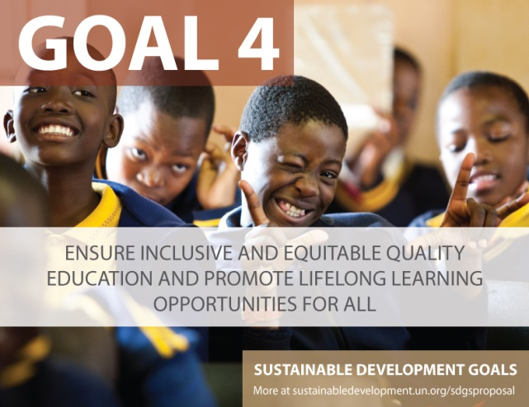

Slide 11
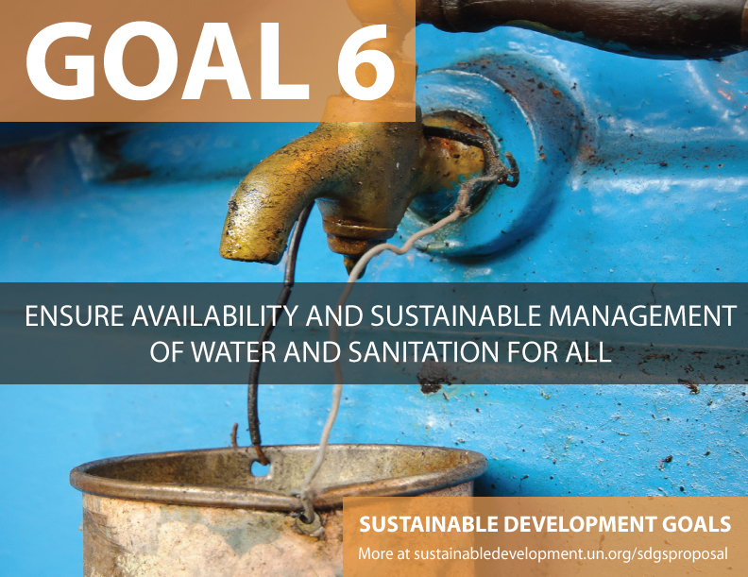
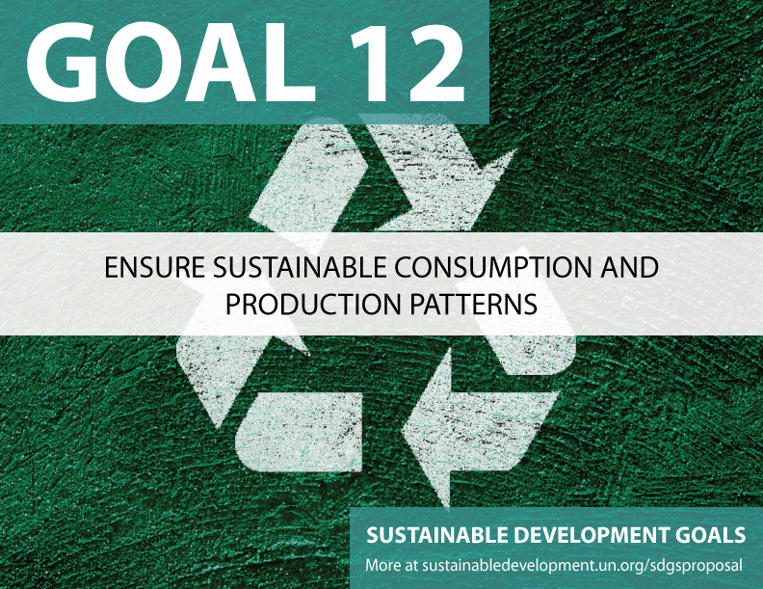
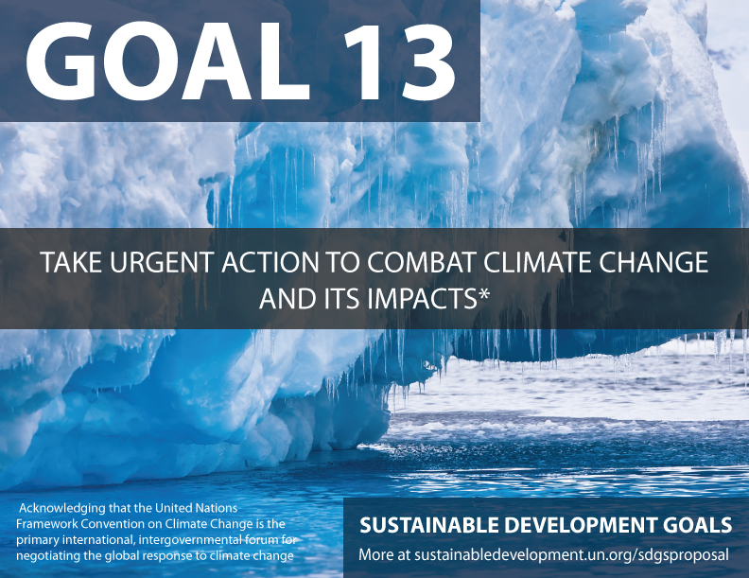
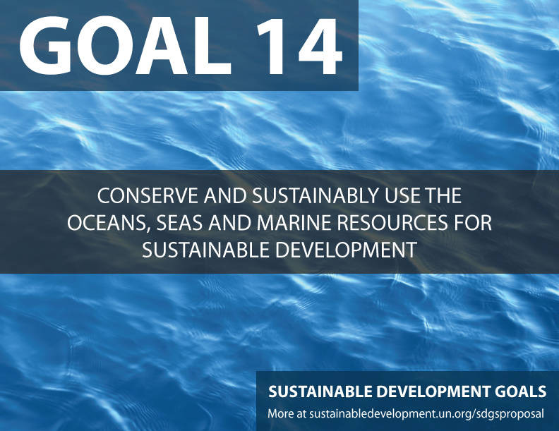
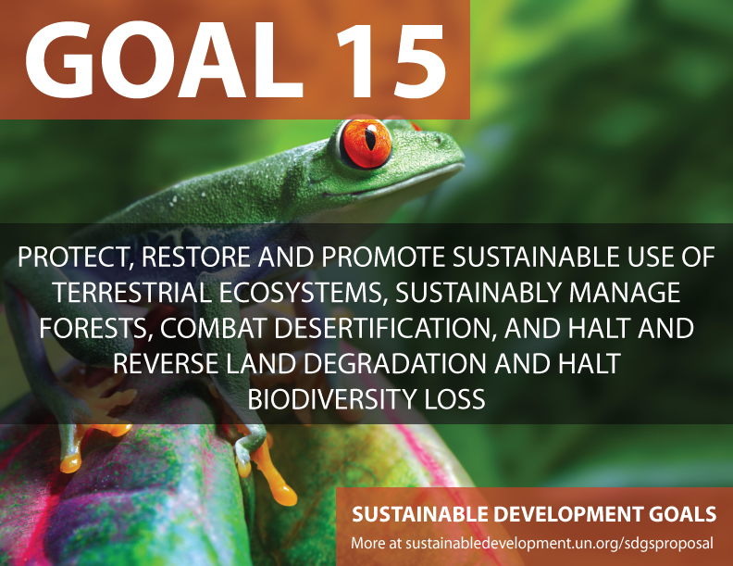
Our common future

Slide 12
“The question of reaching sustainability is not about if we will have enough energy, enough food, or other tangible resources … The question is: will there be enough leaders in time?”
Notes:
https://www.youtube.com/watch?v=zpzrqCr2kE4
Integration of Sustainability into Management Education at McGill

Slide 13
Sustainability should be a central concern when rethinking education as a common good
Teaching and Learning for a Sustainable Future
How can the talent educators and students in XJTLU become more effective role models and change agents within society?
How should we response to changing requirements for learning and teaching towards sustainable future?
Notes:
for HEIs to become sustainability leaders and change agents they must ensure that the needs of present and future generations are better understood and addressed.
How to integrate social and environmental stewardship into curricula and research
Changing requirements for teaching→ to ensure students learn to work in ways that align business activities with the long-term health of society.

Slide 14
Looking outside: what we could learn from those first movers on sustainability education
Beyond Grey Pinstripes
a biennial research survey and alternative ranking of business schools to investigate full-time MBA programs leading the way in the integration of issues concerning social and environmental stewardship into the curriculum.
Notes:
The Institute publishes a yearly ranking of MBA programmes on the distinctive basis of which programmes best prepare managers to create social, environmental and financial value in business rather than on which schools give students the highest salary increases.

Slide 15
Sustainable MBA Program
“There’s a revolution happening in management education, and it’s happening faster than we can keep up with it, the students and the CEOs are driving it.”
---New Lessons in Corporate Citizenship. Forbes. 2006.11.28

Slide 16
“The creation of Harvard’s first University-wide Sustainability Plan is much more than
an exercise in strategic planning. It is an opportunity for every member of our community
to reflect on what role they can play in enhancing our collective well-being for a more
sustainable future.”

Slide 17
“We are at a critical juncture in the
evolution of our relationship to the
environment; and universities must
take the lead in addressing issues
of sustainability.”
“Universities are in a unique position to address the grand challenges of sustainability in the 21st century.”
“we are educating 100 percent of our future political, business, and social leaders. This fact alone places significant accountability on higher education and its leaders to take action.”
Notes:
By 2025 ASU devotes to be a carbon neutral campus

Slide 18
American Campuses Act on Climate Pledge
“As institutions of higher education, …..We recognize the urgent need to act now to avoid irreversible costs to our global community’s economic prosperity and public health and are optimistic that world leaders will reach an agreement to secure a transition to a low carbon future. Today our school pledges to accelerate the transition to low-carbon energy while enhancing sustainable and resilient practices across our campus.”
November 19, 2015
Notes:
November 19, 2015
218 campuses representing over 3.3 million students across the country are committing to take action on climate by signing American Campuses on Climate Pledge

Slide 19
Looking inside: sustainability education gap in XJTLU
Ask three key questions
What is XJTLU do?
What should XJTLU do?
What (else) can XJTLU do?

Slide 20
| Sustainability Education in XJTLU
Limited modules offered for students
Lacking of cross-departmental collaborations and transdisciplinary collaborations
Lacking of faculty development on sustainability education
Joined UN PRME initiative in 2013
A few very active staff on promoting sustainability education
Pioneer to bridge networking with domestic business schools on sustainability education

Slide 21
| XJTLU should do
To develop robust sustainability curricula
To encourage more innovative teaching practices especially on transdisciplinary modules
To establish closer business collaboration to provide consultative teaching

Slide 22
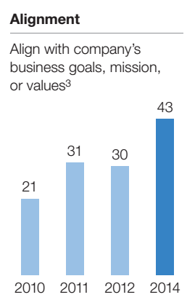
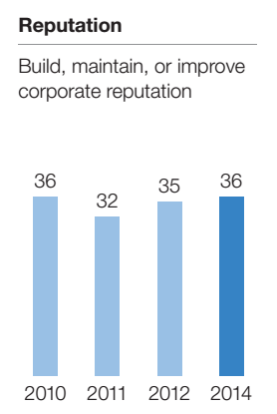
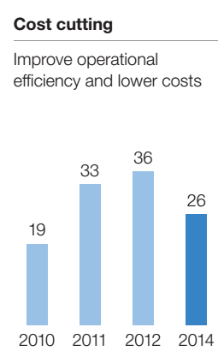
Sustainability’s Strategic Worth (McKinsey, 2014)
Top 3 reasons that respondents’ organizations address sustainability

Slide 23
| What (else) should XJTLU do?
What does sustainability exactly mean for XJTLU in next decade?

Slide 24
UN Global Compact–Accenture CEO study found that 97% of the 1,000 CEOs interviewed across 103 countries and 27 industries see sustainability as important to the future success of their business. Moreover, 78% see sustainability as an opportunity for growth and innovation.
---UN Global Compact–Accenture CEO Study , 2013

Slide 25
Sustainability Education at XJTLU in 2025
Notes:
By treating sustainability as a goal today, early movers will develop competencies that rivals will be hard-pressed to match.

Slide 26
How should we take more active actions to continuously innovate and improve our (sustainability) education?
How should we identify and dive deeply into areas we believe to be of critical importance to our future “Global Citizenship”?
How should we make our campus a LAB of sustainability education?

Slide 27
| We should not ignore
The innovative teaching practices of faculty staff
The hidden agent of change and driving demand from students for more sustainability related contents
The increasing expectations from society including our business partners, local community, government and other social organizations towards XJTLU

Slide 28
| Sustainable campus and sustainability operation
Leadership commitment and support
Sustainability culture
Sustainability plan
Sustainability assessments
Climate change and carbon neutral campus
Report on Sustainability
Impact on local community
Notes:
http://www.international-sustainable-campus-network.org/

Slide 29
| Sustainability competition
GREEN DAY/WEEK
Sustainability IDEAS
Sustainability Design
Student engagement and activities
Public engagement and services

Slide 30
| Sustainability learning and degree
More experiential and action learning
Make differentiation and niche
Interdisciplinary collaboration
Joint program (degree)
Notes:
Sustainable Entrepreneurship MBA Program
Leadership and Sustainability MBA http://www.cumbria.ac.uk/Courses/Subjects/BusinessComputing/Postgraduate/LeadershipSustainability.aspx

Slide 31
| Sustainability Research
Sustainability School
Transdisciplinary Centre
Green Seed RDF
Green Seed SURF

Slide 32
| Sustainability training
Summer School
Business partners
Government bodies
Social organizations

Slide 33
| Sustainability networking
UN PRME
International Sustainable Campus Network
The Association for the Advancement of Sustainability in Higher Education
University Sustainability Alliance
The Sustainability Consortium

Slide 34
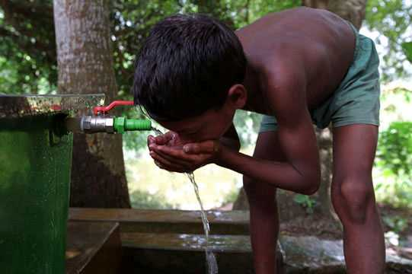
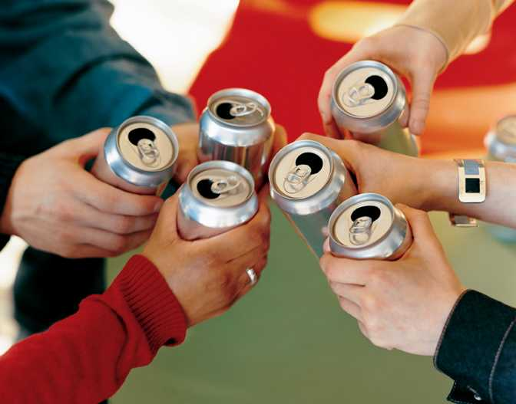
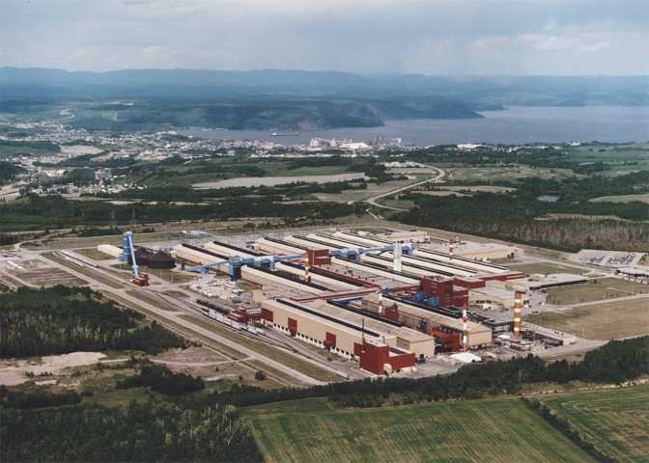
Think broadly about issues and impacts
Engage and partner with stakeholders
Make connections & integrate sustainability within and across disciplines
Think broadly about Value
Notes:
Actions: Addressing key business issues, linking global and local issues, trends and developments with XJTLU’s strategy and activities

Slide 35
曹瑄玮
Xuanwei Cao
xuanwei.cao@xjtlu.edu.cn

