Slide 1
ECC-LC Co-delivery
Penny Scott
Notes:
ECC has 4 year 1 modules co-delivered with LC
I have taught on two and convened one of them
I’m going to give examples 002
1 hour lecture: content
2 hour seminars: 1st hour LC, 2nd hour ECC and LC together
LC endow the students with the skills they need, through the week’s content

Slide 2
ECC: 4 co-delivered modules ENG003 How Language works: 1x 2h lecture (ECC), plus several small groups run by ECC and LC (1 h each) ENG002 Literature and Film: 1x 1h lecture (ECC), plus a 2h large group seminar First hour: LC Second hour: ECC
Notes:
ECC has 4 year 1 modules co-delivered with LC
I have taught on two and convened one of them
I’m going to give examples mostly from the one that I think is working best; it is not the one I convene…
1 hour lecture: content
2 hour seminars: 1st hour LC, 2nd hour ECC and LC together
LC endow the students with the skills they need, through the week’s content

Slide 3
1. Rapid Iteration
E.g. Teaching tools
Iteration through a number of different staff rather than annual deliveries

Slide 4
2. Levelling
Help with levelling of instructions and tasks
Insight: student educational backgrounds

Slide 5
3. Scaffolding
Variety of tasks
Wide variety of teaching practices, e.g. discussion, kinesthetic tasks etc.)
Notes:
e.g. fllm terms to effects

Slide 6
4. Integration of skills and content
Motivation: Content-driven
Skills of argumentation, precision, clarity are not separate from everyday speech and thinking
Co-delivery shows these links
Academic skills, life skills, language skills

Slide 7
5. Assessments
Instructions
Student support in essay writing skills, with a focus on the module content
Marking descriptors – help from LC in devising descriptors and student feedback model

Slide 8
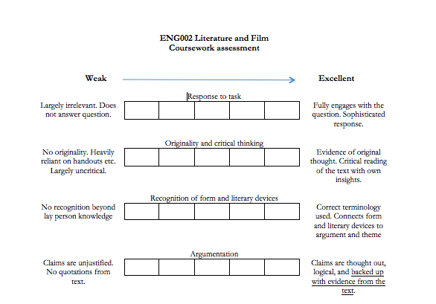

Slide 9
