Slide 2
What does it mean to be a XJTLU Teacher?
Student:
Teacher:
Transition from High School Education
Learning Styles/Preferences/Needs
Cultural Backgrounds and Values
Expectations
Behaviour
Communication
Transition from University/College Job
Teaching Styles/Preferences/Needs
Cultural Backgrounds and Values
Expectations
Behaviour
Communication/Presentation
XJTLU
Student
Non-teaching Staff
Colleagues
Teacher
http://www.funvideofun.com/funny-videos/professor-smashes-phone

Slide 3
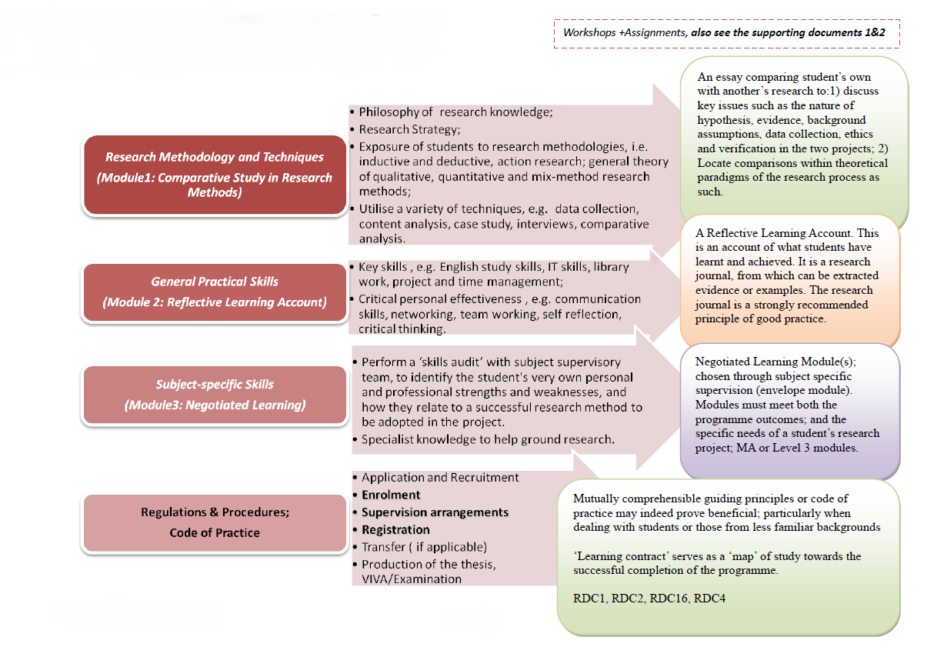
SKILLS DEVELOPMENT IN RESEARCH

Slide 4
What does it mean to be a XJTLU Teacher?
Student:
Teacher:
Transition from High School Education
Learning Styles/Preferences/Needs
Cultural Backgrounds and Values
Expectations
Behaviour
Communication
Transition from University/College Job
Teaching Styles/Preferences/Needs
Cultural Backgrounds and Values
Expectations
Behaviour
Communication/Presentation
XJTLU
Student
Non-teaching Staff
Colleagues
Teacher

