Slide 1
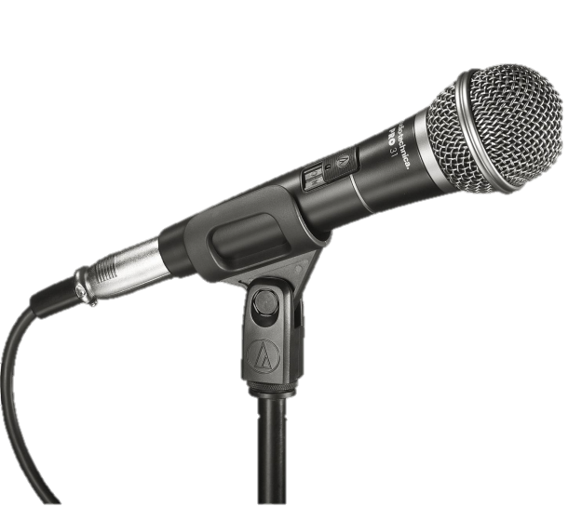
Listening to Student Silence in Transnational Education
Richard Galletly & Chanzi Bao
A TDF project

Slide 2
“Why are students silent in [my] class?”
“Maybe there’s something wrong with the way I teach?”
“My students are never silent: I make my students talk”
“That’s simple. Just vary your tasks, include more speaking activities, warmers, learn their names, etc…”
“Not my fault”, but maybe it is ?
Maybe some classes are more silent than others. Why is that?
It seems simple, but probably isn’t

Slide 3
A study of the silent classroom ‘system.’
Small changes can be powerful…
Aim: to contribute towards informed teaching practices
Recommendations: teachers can achieve large (and unpredictable?) effects by making small changes to the classroom ‘system’ (DST: the ‘butterfly effect’)
– Lorenz, 1963; de Bot et al., 2007

Slide 4
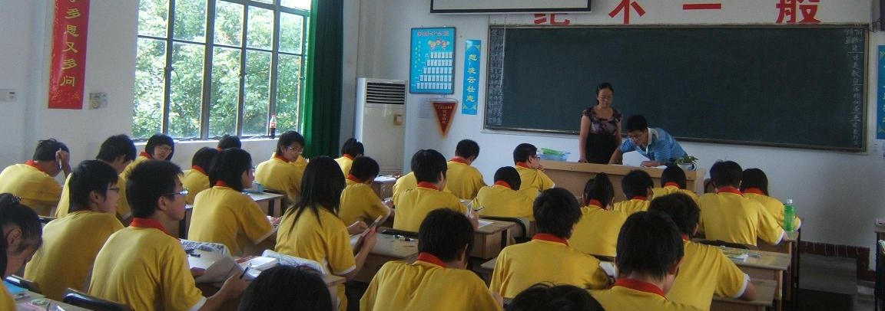
The ‘challenge’ of TNE
Different educational traditions: Chinese education is said to be “teacher-centred,” UK education requires “critical thinking, group discussion & independent learning.” Chinese students said to be “dissatisfied with TNE”, and “not prepared for a communicative approach” (Zhuang & Tang, 2012).
Is this your experience?
Is student silence a “reaction to the western HE environment?” (Grimshaw, 2007)

Slide 5
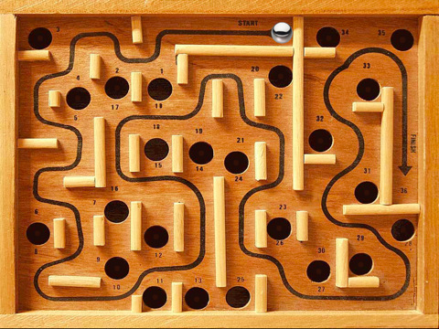
The Student Silence ‘Maze’
Linguistic
Behaviour
Prepositions
Pragmatism
Pronunciation
Psychology
Task comprehension
Pedagogy
Subject-specific Vocabulary
Social
Articles
Nouns &
verbs
Culture
Tenses

Slide 7
枪打出头鸟
!!!!!!
A Chinese proverb…
[the gun] shoots the bird which takes the lead: the person who speaks first?
- Chinese Culture? - or pragmatism?
Notes:
Translations: Shoot the bird which takes the lead; The gun hits person who takes the lead; Common fame is seldom to blame.

Slide 8
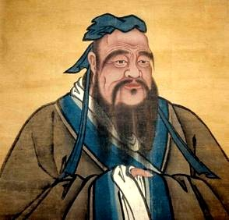
Silence & Chinese culture
Silence is a true friend who never betrays
- Confucius
Chinese students will be silent to avoid criticism, ridicule, rejection, to win approval, acceptance or appreciation, and to ensure their opinions are safely “the same as those of others” (Yang, 1993), establish harmony by preserving “face” (Yu, 2011); ‘self-censor’ to conform to ‘socially expected norms’ (Qi, 2011).
Hypothesis 1: Chinese Culture is related to Student Silent Behaviour (SSB) in Transnational Education (TNE)

Slide 9
Silent behaviour & gender norms
Tang
dynasty
‘Face’ effects: Chinese males avoid criticism & moderate their emotions at all times; Chinese female students affected by cultural landscape & family orientation (Wang, 2010); Confucian traditions vs the ‘levelling effects of Marxism’ Have gender inequalities reversed? or not?
Hypothesis 2: Student gender moderates CC on SSB in TNE

Slide 10
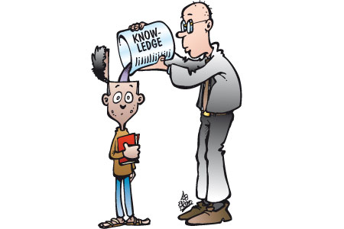
A history of silence in the Chinese classroom?
Hypothesis 3: Pedagogic history affects SSB in TNE in China.
Teachers are “authoritarian” in Chinese schools, and students are “quiet and obedient” (Sit, 2013). Teachers assumed to be able to answer all the students’ questions, an ‘empty vessel’ approach (Allen & Spada, 1982). Chinese learners take a ‘deep approach’ to learning, ask questions after a long reflection, e.g. after class (Sit, 2013).

Slide 11
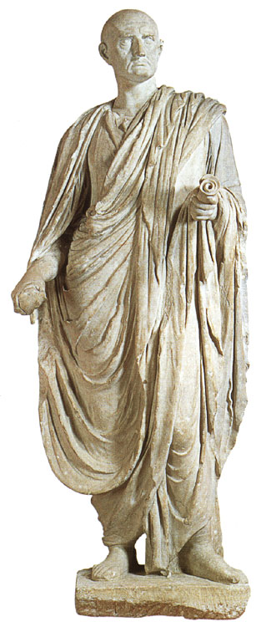
Pragmatism
Silence: one of the “great arts of conversation”
- Cicero
Silence gives students the right to conceal thoughts, choose words carefully, to avoid embarrassment, or preserve privacy;
A chance for personal exploration, independence or isolation.
“…speak only if the quality of what one has to say is greater than the silence that one interrupts” (Bilmes, 1994: a Chinese saying?)
Hypothesis 4: Pragmatism positively related to SSB in TNE

Slide 12
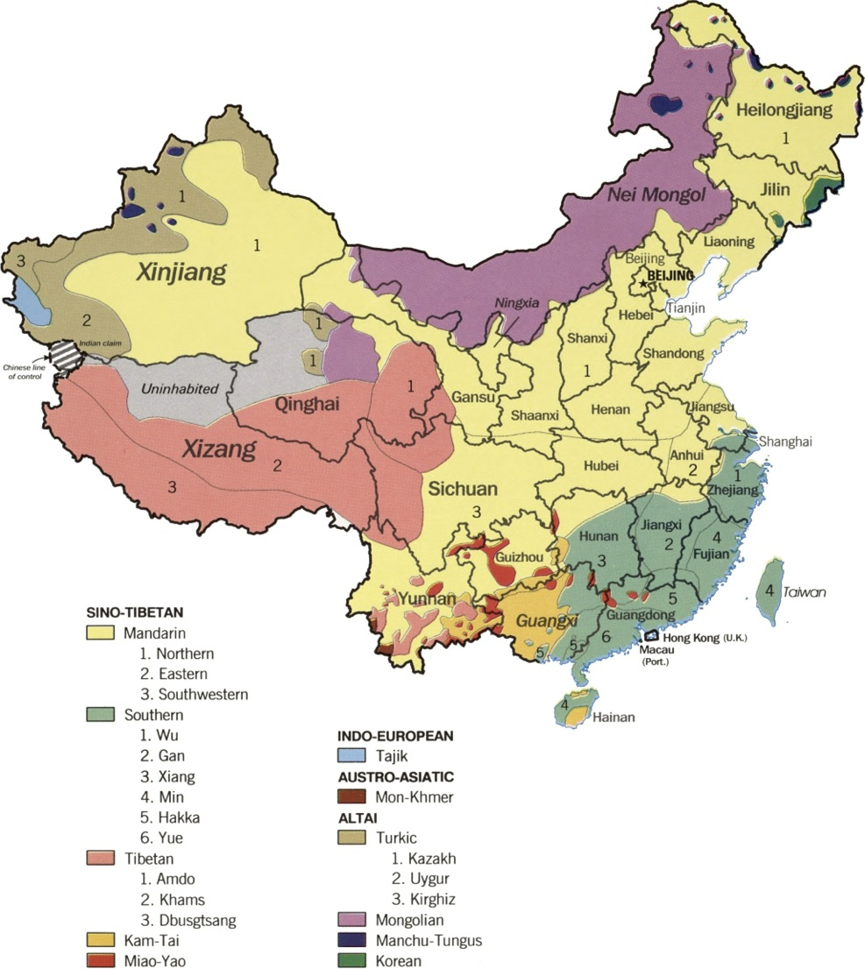
Linguistic map of China
“Great social and regional inequalities due to rural migration and rural poverty” (Zhiyong, 2010)
One Culture?
… in different locations?
… consistent over time?
(Tung & Verbeke, 2010)
Hypothesis 5: Province of origin affects SSB in TNE in China.
(CIA, 1990)

Slide 13
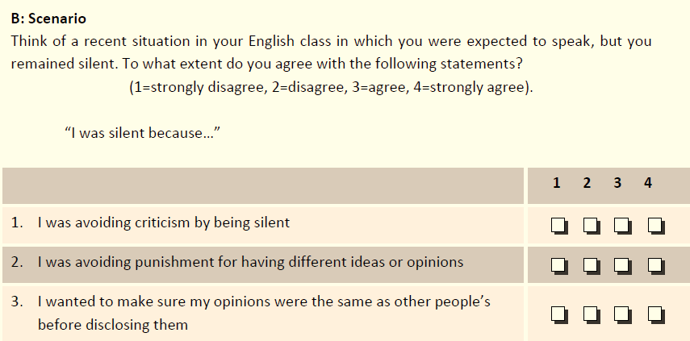
The survey
Year 1 (2014): 545/ 681 students; Year 2 (2015): 648/ 862 students
24 statements derived from a literature review & written in Chinese. Space for ‘additional comments.’

Slide 14
Pragmatic Pedagogic Culture Pragmatic Social Pragmatic

Slide 15
Culture – student gender: “I wanted to make sure my opinions were the same as other people’s before disclosing them”
ANOVA: F(1,602) = 5.26, p = 0.02
No significant correlation (2015).

Slide 16
Pedagogy – Province of Origin I was silent because I am used to a different teaching method at school
2014: ANOVA: F(33,505) = 1.56, p = 0.026 2015: No significant correlation
agree
disagree

Slide 17
“I'm silent because I don't want to be put under [the] spotlight.”
Chinese Culture - Year 1, 2014
“I don’t want to be high-key or conspicuous, I just want to act like other students. I want to be modest”

Slide 18
“If the teacher can … create an atmosphere of free questions and answers, then the situation should improve”
Pedagogy - Year 2, 2015
“if we are not talking, I feel the need for teachers to ‘push’ … ‘Chinese-style-education’ students need to be encouraged”

Slide 19
Communicative behaviour
Silent behaviour
DST (de Bot, Lowie & Verspoor, 2007)

Slide 20
Recommendations
Allow silent preparation time before discussions, don’t ask until students are prepared
Seek to understand (and act upon) the sociocultural ‘landscape’ of the classroom ‘system’ * & push!
Create a ‘risk-free environment’, the freedom to make mistakes (a ‘democratization’ of the classroom)**
Small changes can be powerful…
* (de Bot et al., 2007; King, 2013)
** (Whiteside & Barclay, 2013)

Slide 21
Adelson, J.L., & McCoach, D.B. (2010). Measuring the Mathematical Attitudes of Elementary Students: The Effects of a 4-Point or 5-Point Likert-Type Scale. Educational and Psychological Measurement, 70(5), 796-807.
Bilmes, J. (1994). Constituting silence: Life in the world of total meaning. Semiotica, 98(1-2), 73-88.
Bruneau, T. J. (1973). Communicative silences: Forms and functions. Journal of Communication, 23(1), 17-46.
Cohen, L., Manion, L., & Morrison, K. (2011). Research methods in education. Milton Park. Abingdon, Oxon, England: Routledge.
Davis, E., Greenberger, E., Charles, S., Chen, C., Zhao, L., & Dong, Q. (2012). Emotion experience and regulation in China and the United States: How do culture and gender shape emotion responding? International Journal Of Psychology, 47(3), 230-239.
de Bot, K., Lowie, W., & Verspoor, M. (2007). A dynamic systems theory approach to second language acquisition. Bilingualism language and cognition, 10(1), 7.
Dörnyei, Z., & Ushioda, E. (2011). Teaching and researching: Motivation. Routledge.
Ephratt, M. (2008). The functions of silence. Journal of pragmatics, 40(11), 1909-1938.
Fang, T. (2003). A critique of Hofstede’s fifth national culture dimension. International journal of cross cultural management, 3(3), 347-368.
FitzPatrick, M., Davey, J., & Dai, L. (2012). Chinese students' complaining behavior: hearing the silence. Asia Pacific Journal of Marketing and Logistics, 24(5), 738-754.
Gass, S. M. (2001). Innovations in second language research methods. Annual Review of Applied Linguistics, 21, 221-232.
Goffman, E. (1967). On face-work. Interaction ritual, 5-45.
Grimshaw, T. (2007). Problematizing the construct of ‘the Chinese learner’: insights from ethnographic research. Educational Studies, 33:3, 299-311
Hoare, R. J., & Butcher, K. (2008). Do Chinese cultural values affect customer satisfaction/loyalty?. International Journal of Contemporary Hospitality Management, 20(2), 156-171.
Hu, Y., & Fell-Eisenkraft, S. (2003). Immigrant Chinese students' use of silence in the language arts classroom: Perceptions, reflections, and actions. Teaching and learning grand forks, 17, 55-65.
Huang, Y. (2013). Towards better gender equality? Portrayals of women in Chinese magazine advertising. American Academy Of Advertising Conference Proceedings, 35-45.
Hwang, A., Ang, S., & Francesco, A. M. (2002). The silent Chinese: The influence of face and Kiasuism on student feedback-seeking behaviors. Journal of Management Education, 26(1), 70-98.
King, J. E. (2011). Silence in the second language classroom. Ph.D. Thesis [online] http://etheses.nottingham.ac.uk/3498/1/555328.pdf [accessed 20.07.2014]
King, J. (2013). Silence in the second language classrooms of Japanese universities. Applied linguistics, 34(3), 325-343.
Kurzon, D. (2007). Towards a typology of silence. Journal of Pragmatics,39(10), 1673-1688.
Kwon, J. W. (2012). Does China have more than one culture?. Asia Pacific Journal of Management, 29(1), 79-102.
Leung, S. (2011). A Comparison of Psychometric Properties and Normality in 4-, 5-, 6-, and 11-Point Likert Scales, Journal of Social Service Research, 37:4, 412-421.
Qi, X. (2011). Face: a Chinese concept in a global sociology. Journal of Sociology, 47(3), 279-295.
Saville-Troike, M. (2003). The ethnography of communication: an introduction (Vol. 14). John Wiley & Sons.
Sit, H. H. W. (2013). Characteristics of Chinese Students’ Learning Styles. International Proceedings of Economics Development & Research, 36-39.
Sung, S., & Pascall, G., (2014). Gender and welfare states in East Asia [electronic book]; confucianism or gender equality? Editors: Sung, S. & Pascall, G. Basingstoke: Palgrave Macmillan, 2014.
Talbot, M. M. (2010). Language and gender. Cambridge, UK. Polity Press.
Tannen, D. (1985). Silence: anything but. Perspectives on silence. 93-111.
Tung, R. L., & Verbeke, A. (2010). Beyond Hofstede and GLOBE: Improving the quality of cross-cultural research. Journal of International Business Studies, (8). 1259
Van Lier, L. (2004). The semiotics and ecology of language learning. Utbildning & demokrati, 13(3), 79-103.
Wang, X. G., (2010). Girls' Access to Education in China: Actors, Cultures and the Windmill of Development Management. CREATE Pathways to Access. Research Monograph No. 39.
Whiteside, D. B., & Barclay, L. J. (2013). Echoes of silence: employee silence as a mediator between overall justice and employee outcomes. Journal of Business Ethics, 116(2), 251-266.
Yu, M. C. (2003). On the universality of face: Evidence from Chinese compliment response behavior. Journal of Pragmatics, 35(10), 1679-1710.
Yu, M. (2011). Effect of communication variables, affective variables, and teacher immediacy on willingness to communicate of foreign language learners. Chinese Journal of Communication, 4(02), 218-236.
Zhiyong, Z. (2010). Higher education access and equality among ethnic minorities in China. Chinese Education & Society, 43(1), 12-23.
Zhou, Y.R., Knoke, D., & Sakamoto, I. (2005). Rethinking silence in the classroom: Chinese students’ experiences of sharing indigenous knowledge. International Journal of Inclusive Education, 9(3), 287-311.
Zhuang, L. (2009). The challenges facing Sino-UK transnational education: an institutional experience. Journal of knowledge-based Innovation in China, 1(3), 243-255.
Zhuang, L., & Tang, A. X. (2012). Sino-UK transnational education in China: rhetoric versus reality. Journal of Technology Management in China, 7(2), 218-234.

