Slide 2
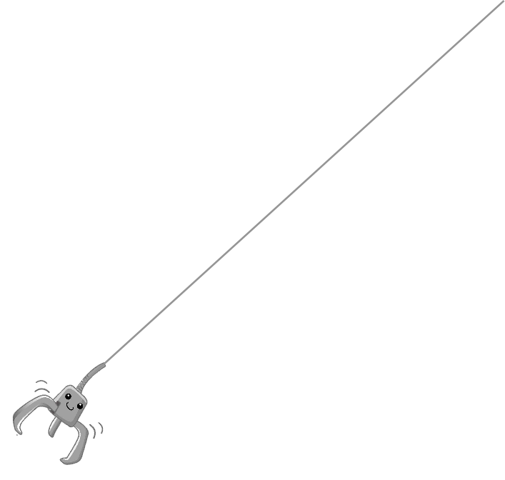
Stage 1
Q1:
Do you love animals?
Q2:
Why do elephants have a good memory?
Q3:
Should animals be kept in zoos? Why / Why not?
Q5：
Do you agree or disagree?
It is important that humans understand how animals communicate.
Q4:
Can humans build relationships with animals?

Slide 3
You made it to the next level!

Slide 4
Stage 2
Q1:
Crowdfunding is better than the traditional way to finance a business.
Q4:
Do you agree or disagree?
A business must keep up with modern technology to be successful.
Q3:
Which is more important for a business, profit or contribution to society?
Q2:
Do you know any company’s mission statement?
Q5:
How can a business compete with others?

Slide 5
You made it to the next level!

Slide 6
Stage 3
Q1:
Would you like to learn about your DNA?
Q3:
Should people have to give their DNA to the government?
Q2:
Should scientists continue to develop knowledge about how to change genes?
Q5:
Why do people use Performance Enhancing Drugs (PEDs)?
Q4:
Would you use gene therapy to improve your health?

Slide 7
You Win!

