Slide 1
2015 XJTLU ANNUAL TEACHING AND LEARNING STAFF COLLOQUIUM
An Investigation of Online Teaching Method Application for Year 1 Courses in CCTC at XJTLU
By Dr. Kai Liu, Dr. Jingqiu Zhan, Xinxin Xu, Wenbei Lv & Kristin Reimer Rojas
G40E, Central Building, XJTLU, 17th April 2015

Slide 2
List of contents
Research Background—Five Star Education Model &
Chinese Culture Teaching Center (CCTC)
CCTC Online Teaching & Learning Platform: Utalk
Research Questions
Research Objectives
Research Methodologies
Questionnaire Design
Current Research Findings

Slide 3
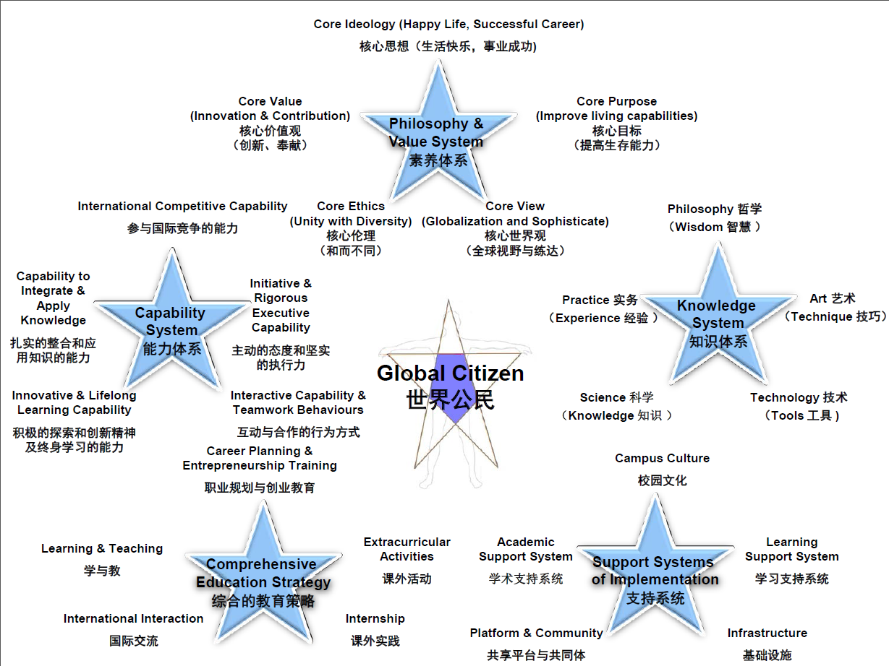
Research Background

Slide 4
Research Background
Chinese Culture Teaching Center (CCTC)—Responsible for Year 1 Mandatory
Course Teaching Required by MoE & Optional Course Teaching at XJTLU.
Mandatory Courses:
Optional Courses: More Than 100 Courses Including Philosophy, Science & Technology,
Sport & Art, Practical Skill at Evening, Weekend and Summer Holiday.
Assessment System: Formative Assessment & Summative Assessment
Self-management
Chinese & Western Culture Comparison
Law & Morality
Modernization Process of China
Self-management: 30%(Final Exam), 30%(Micro Film),
20%(In-class Quiz), 20%(Online Discussion)
Other Courses: 60%(Final Exam), 20%(In-class Quiz),
20%(Online Discussion)

Slide 5
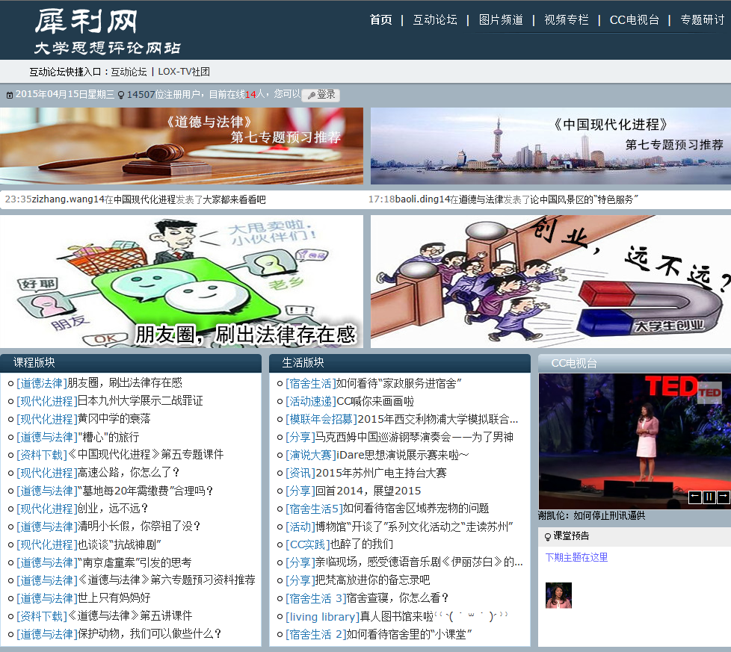
CCTC Online Teaching & Learning Platform: Utalk
http://Utalk/

Slide 6
RESEARCH QUESTIONS
To what extent does the online teaching methods assist in students’ learning and satisfy the communication need between students and lecturers?
How does the online teaching methods used by CCTC for Year 1 courses at XJTLU improve students’ capabilities?
Are there any better solutions to improve the use of online teaching methods to optimize future supervision and assessment of students’ learning?

Slide 7
Research Objectives
Objectives
Examine Current Online Teaching Methods Applied by CCTC for Year 1 Courses at XJTLU.
Identify Their Application Problems in Terms of Teaching Source Preparation, Lecturer-student Online Interaction and Students’ Learning Feedback.
Propose Solutions for Improving Future Online Teaching Methods.
Ultimate Goal: Enhance Students’ Learning Ability, Cultivate Students’ Independent and Critical Thinking Mindset, Improve Students’ Communication Skill, Build up Students’ Moral Character, and Achieve the Ultimate Goal of FSEM at XJTLU.

Slide 8
Research Methodologies
Library & Online Database
Questionnaire & Interview
Analytical Method
Critical Method
Comparative Method
Pilot Study

Slide 9
Questionnaire Design
Section A: Personal Information (Single Choice)
Gender, Learning Area, Origin, Online Learning Experience, CCTC Course Result.
Section B: Online Teaching Methods (Single Choice)
Aim to understand students’ general attitude towards using online teaching methods for higher
education. (Strongly Disagree, Disagree, Neutral, Agree, Strongly Agree)
Section C: Utalk (Uncertain Item Choice)
Aim to understand students’ feelings & opinions on the use of CCTC’s online teaching platform.
Section D: Evaluation of Utalk (Single Choice)
Aim to assess students’ learning outcomes through CCTC’s online teaching platform.
(Strongly Disagree, Disagree, Neutral, Agree, Strongly Agree)

Slide 10
Current Research Findings
Initial Stage: Data Collection, Questionnaire Design
Pilot Study: Questionnaire Improvement
Streamline the Teaching Methods: Targeted Teaching
Optimize the Contents of Utalk for Teaching & Learning
Diversify the Assessment Channels for Learning: e.g. Wechat

Slide 11
Thanks for Your Attention !

