Slide 1
Introducing Customized Video Demonstrations into the Future Lab-based Teaching at XJTLU
Presenters: Ying Cheng, Yang Du and Shaofeng Lu

Slide 2
Lab-based Teaching
Takes an important part in a wide range of engineering and science disciplines
Heavily relies on live demonstrations.
This becomes particularly problematic when the number of students becomes large.

Slide 3
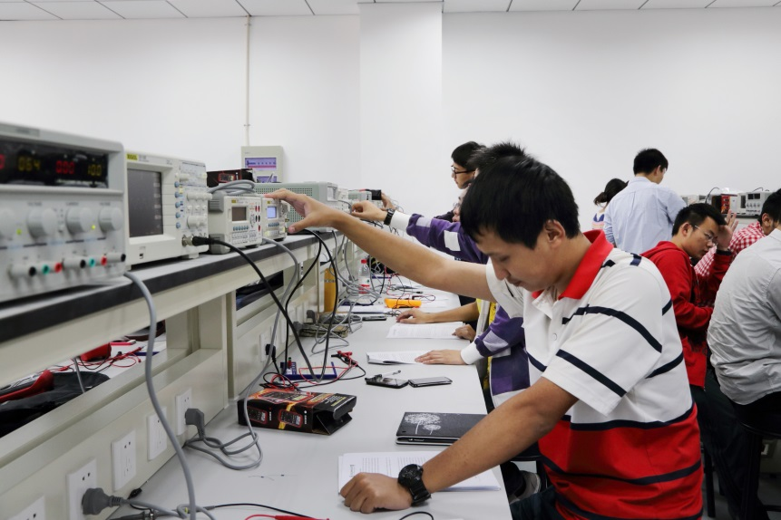
Lab-based Teaching- Typical Issues
Insufficiency on the lab-supporting system
Live demonstrations are constrained by learning time and space
Key learning information is likely to be missed in current practices

Slide 4
Customized Video Demonstrations - An Introduction
This TDF project introduces the customized video demonstration (CVD) into our lab-based teaching practices.
Carefully designed and tailored
Seamlessly integrate the theoretical and practical information

Slide 5
Customized Video Demonstrations – Objectives
More learning details
Eliminate the learning time and space constraints
Integration with virtual learning environment at XJTLU
Enhance the current lab-based practice and inspire other teaching practices at XJTLU

Slide 6
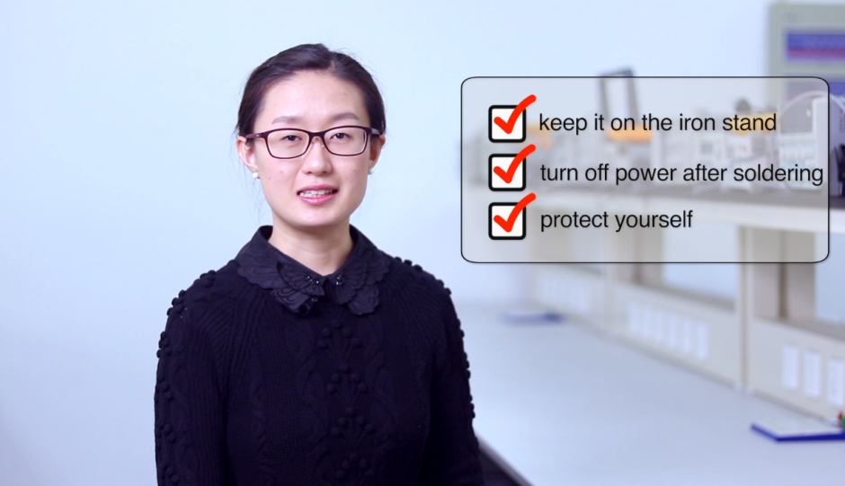
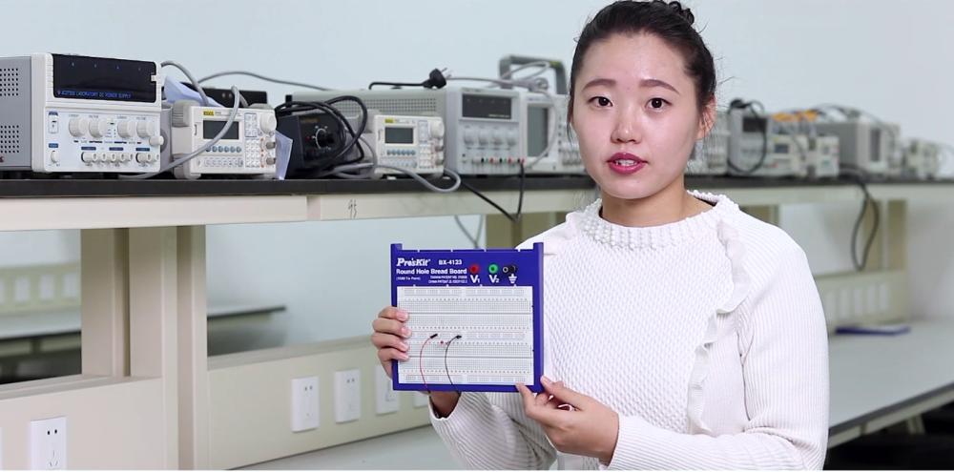
Sample Video Demonstration
Soldering skills
Breadboards

Slide 7
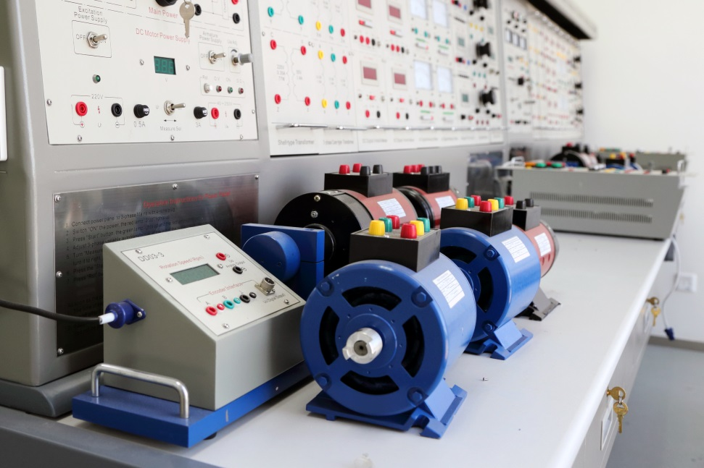
Two Research Questions
Will CVDs be beneficial to enhance the learning and teaching experiences of the students during the lab-based teaching practices? (Questionnaires)
How can we effectively apply CVDs to enhance the performance of students?(Comparative study)
Notes:
First question

Slide 8
Question 1: Student Feedbacks of CVD on Soldering Skills
84% of responding students agree or strongly agree that the CVD helped them improve the soldering skills.
86% of responding students prefer watching videos rather than instructions in texts or pictures.
82% of responding students agree or strongly agree that the CVD is clear and easy to understand.

Slide 9
Question 2: Comparative study
The effectiveness of CVDs
To investigated through a designed comparative study.
Three groups of students will be chosen: one with live demonstrations, one with CVDs, and the other without.
To contrast the performance of students from different groups during the lab.

Slide 10
Project Progress
We have produced two sampled CVDs on Soldering Skills and Breadboards.
We have used the CVD on Soldering skills for lab-based teaching in a year-two module to support teaching and learning.
Feedbacks from students have been collected to evaluate the effectiveness of the CVD.

Slide 11
Future Work
As the ultimate goal, we will set up our own studio to create different kinds of CVDs to support our future lab-based teaching practices.
We will investigate if it is possible to standardize the customized-video-making process inside XJTLU.
This studio will be used for other teaching purposes beyond lab-based teaching.

Slide 12
Summary and Conclusions
Traditional lab-based teaching relying on live demonstrations becomes problematic when the number of students increases
Customized Video Demonstration is proposed to address typical issues during the lab-based teaching.
Preliminary use of CVD received positive feedbacks and the effectiveness is yet to be found via comparative studies.
A studio will be built in future to generate more high-quality CVDs to meet the lab-based learning and teaching needs at XJTLU.

