Slide 1
Staff-student partnership and peer facilitation fostering student engagement and teaching skills development
Luciane V. Mello
School of Life Sciences, University of Liverpool
3rd Annual XJTLU Learning and Teaching Staff Colloquium, 2015

Slide 2
Outline of the talk
Rationale:
Bioinformatics
Student employability and student learning
Peer-learning & staff-student partnership
Project: aims, planning process & the activity
Project’s results
Project’s impact & conclusions
Transferability

Slide 3
Rationale:
Biology students have difficulties when learning bioinformatics
No familiarisation with the area when in secondary/high school
No clear understanding of the use of bioinformatics
Link with computer language and maths
No confidence
UoL: optional module not always taken by students (especially organism [not molecular] orientated degrees)

Slide 4
Rationale: Bioinformatics is a skillset that underpins most of modern biology
Biology students attempt bioinformatics analysis in their UG research projects:
Without proper knowledge – especially those with no training at all
Students rely on the web tools (easy access), but lack proper results analysis skills
Incomplete/incorrect use of the resources

Slide 5
Rationale: Bioinformatics is a skillset that underpins most of modern biology
Bioinformatics PG research
How are the topics related?
Same module
Cross-modules
How can we put in practice what we’ve learned?
Application in research projects

Slide 6
Rationale: Training and employability
The Research Councils doctoral training & employability (2012)
research skills
expertise in teaching
The reality: <25% of applicants for Lecturer have such expertise
Action:
Russell Group Universities target for additional teacher training:
Formal teacher training is beginning to be offered at postgraduate level at some universities
UCL (2013)
UoL (Teaching for researchers training)
Notes:
http://books.google.co.uk/books?id=BLjnDGlJL0cC&pg=PA246&lpg=PA246&dq=postgraduates+with+formal+teaching+training+hefce&source=bl&ots=zL4Heh5-xu&sig=1XCbbiTE-Hbw_Jkhy85nFUzeFQc&hl=en&sa=X&ei=zPKfU7e4CYfvOsTWgIAC&ved=0CCUQ6AEwAQ#v=onepage&q=postgraduates%20with%20formal%20teaching%20training%20hefce&f=false
Formal training at UCL: http://www.ucl.ac.uk/teaching-learning/news/training-for-pgtas

Slide 7
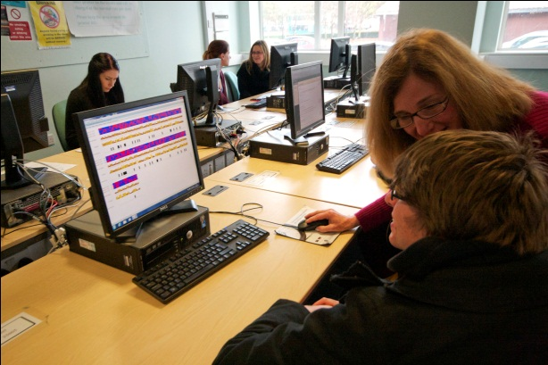
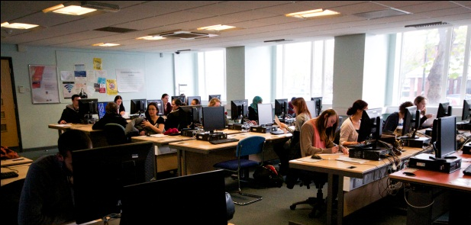
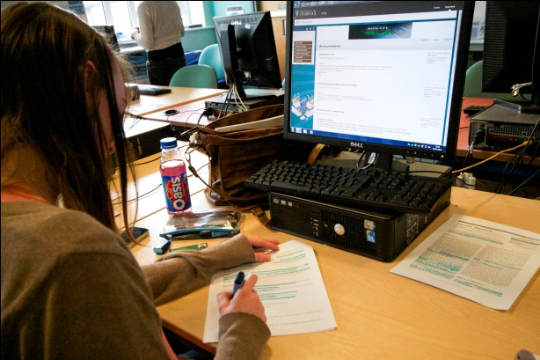
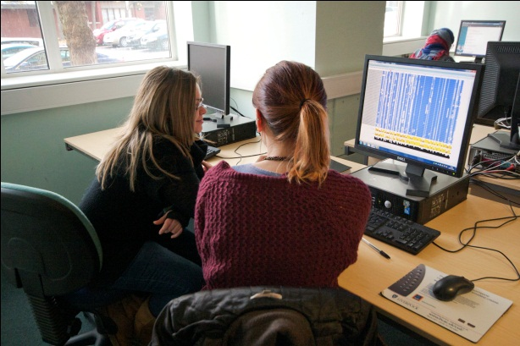
Bioinformatics training
and
Students’ teaching training and employability

Slide 8
Educational approach: Peer-learning & staff-student partnership
1. Peer-learning, peer-assisted learning
Students learn a great deal by explaining their ideas to others and by participating in activities in which they can learn from their peers (Gwee, 2014)
2. Staff-student partnership
It involves students and lecturers working together and taking shared responsibility in the enhancement of student learning (Healey, 2012)

Slide 9
The case study: a bioinformatics module at postgraduate level

Slide 10
Aims
Module:
Add context to bioinformatics teaching
Peer-receivers: current cohort (Masters and PhD)
Content relevance and connection
Transferability and application to future work
Improve their thinking skills
Peer-facilitators: past students (PhD)
Develop teaching skills – employability
Increase understanding (topic, project) - learning

Slide 11
Planning the project: colleagues’ input
“… I can clearly see this activity fostering Master students' reflection on their research project. This activity will help to close gaps between modules…” (Master Programme Director)
“We perennially struggle at all levels to convince our students that the transferable skills we equip them with will be relevant at later stage of their programme…” (Chair, SLS Quality Enhancement Group)
Notes:
One of my perception & students’ feedback, but before embarking in the project, I spoke to colleagues…..
Targeting skill of student reflection on their knowledge – learn and apply information
Transferable skills

Slide 12
Planning the project: peer-facilitators’ input
”Had such an opportunity been made available to me during my time studying the module, it would have made a great deal of improvement to both my learning and my research as a result”
“..I believe that retrospectively presenting my work in terms of the application of principles from this module will strengthen my own knowledge of my project…..”
organism
"..As an ecologist, it wasn't immediately obvious that I needed bioinformatics skills, and so my engagement with this module was not whole-hearted. In reality, however, I regularly use several tools in my research."
Notes:
Things to highlight:
Try to address issues that were lacking when we were students
To teach we need to understand better
Partnership of staff and students

Slide 13
The activity: inter-cohort peer learning
Nine peer-facilitators presented their experiences
With the module
With content transferability to their research project
(2x) 10 minutes presentation prior workshop
How I applied what you will learn today!
Helping peer-receivers in the workshop
Discussion session: let’s talk about OUR research projects!

Slide 14
Evaluation & Results
Peer-facilitators
Questionnaire : 100% respondents
Reflective log: 100% participation
Peer-receivers
Questionnaire: ~75% respondents (2013-14)
~ 50% respondents (2014-15)
Postgraduate cohort
Notes:
77% in total
PhD 70%, MSc 63%, MBiolSci 86% and MRes 88%

Slide 15
Peer-facilitators
Notes:
Emphasise link with project aims

Slide 16
Peer-facilitators’ view on receivers engagement
Some students downloaded my slides from the VLE
I was really amazed by the level of response and active discussion in the workshop
..a pair of students asked for advice on analysing their data, having taken notes of similar analysis explained in the presentations
Figure 3. Results from the quantitative analysis (questionnaire) from peer-facilitators
Figure 4. Qualitative responses from peer-facilitators extracted from the questionnaire and reflective log book.
Future directions
The number of responses received from the students via the questionnaires was very positive, with most (~70%) of the students volunteering time to share their views on the Students as Partners program (Figure 1). Together with this, the general responses to the questions are extremely encouraging (average ~80% positive responses, Figure 2) in support of continuing the program in subsequent years.
Responses to the peer-facilitator questionnaires (Figures 3 & 4) were 100% positive (90% response level), suggesting that the benefits of the program are not limited exclusively to the peer-receivers.
Further success of the Students as Partners program in BIOL721 module will depend on continued enthusiasm from both peer-facilitators and receivers, with results from the current program looking promising. Interest in taking part in the program was voiced by the peer-receivers, which should ensure the continuation of the project in subsequent years. Continued success could also act to facilitate the launch of similar programs across the university in the future. While adding to the student and staff experience in their respective modules, these programs will also improve the value of a place at the University of Liverpool.

Slide 17
Teaching skills development
It was really a rare and valuable opportunity to place myself between being a student and a tutor
I was also able to learn a little about student behaviour. Good teaching experience
..I enjoyed the satisfaction of having shared my personal research journey with others..
Figure 3. Results from the quantitative analysis (questionnaire) from peer-facilitators
Figure 4. Qualitative responses from peer-facilitators extracted from the questionnaire and reflective log book.
Future directions
The number of responses received from the students via the questionnaires was very positive, with most (~70%) of the students volunteering time to share their views on the Students as Partners program (Figure 1). Together with this, the general responses to the questions are extremely encouraging (average ~80% positive responses, Figure 2) in support of continuing the program in subsequent years.
Responses to the peer-facilitator questionnaires (Figures 3 & 4) were 100% positive (90% response level), suggesting that the benefits of the program are not limited exclusively to the peer-receivers.
Further success of the Students as Partners program in BIOL721 module will depend on continued enthusiasm from both peer-facilitators and receivers, with results from the current program looking promising. Interest in taking part in the program was voiced by the peer-receivers, which should ensure the continuation of the project in subsequent years. Continued success could also act to facilitate the launch of similar programs across the university in the future. While adding to the student and staff experience in their respective modules, these programs will also improve the value of a place at the University of Liverpool.

Slide 18
Understanding bioinformatics
I was able to learn more about bioinformatics applications from others peer-facilitators
critical thinking
Thinking precisely about how I used bioinformatics as part of my work gave me opportunity to view my own research in a new way
Figure 3. Results from the quantitative analysis (questionnaire) from peer-facilitators
Figure 4. Qualitative responses from peer-facilitators extracted from the questionnaire and reflective log book.
Future directions
The number of responses received from the students via the questionnaires was very positive, with most (~70%) of the students volunteering time to share their views on the Students as Partners program (Figure 1). Together with this, the general responses to the questions are extremely encouraging (average ~80% positive responses, Figure 2) in support of continuing the program in subsequent years.
Responses to the peer-facilitator questionnaires (Figures 3 & 4) were 100% positive (90% response level), suggesting that the benefits of the program are not limited exclusively to the peer-receivers.
Further success of the Students as Partners program in BIOL721 module will depend on continued enthusiasm from both peer-facilitators and receivers, with results from the current program looking promising. Interest in taking part in the program was voiced by the peer-receivers, which should ensure the continuation of the project in subsequent years. Continued success could also act to facilitate the launch of similar programs across the university in the future. While adding to the student and staff experience in their respective modules, these programs will also improve the value of a place at the University of Liverpool.

Slide 19
Peer-receivers
14-15
Improved understanding of workshop
13-14
14-15
Improved engagement with module
13-14
Improved understanding of
bioinformatics applications to other
projects
14-15
13-14
Improved understand of
bioinformatics applications to my
research project
14-15
13-14
Percentage of students

Slide 20
Project’s impact & conclusions
some peer-receivers asked to act as peer-facilitators

Slide 21
Transferability
Likely to be applicable to most ‘skills’ modules:
Lab techniques
Statistics
Key skills: communication, employability (transferable skills)
UoL also implemented: UG level
Bioinformatics UG module
Future plans:
Statistics module

Slide 22
Transferability
Inter cohort peer-learning
XJTLU students:
Case 1:
Peer-receivers: Y2 in Liverpool
Peer-facilitators: Y3 in Liverpool
Case 2:
Peer-receivers: Y1 (Y2) in XJTLU
Peer-facilitators: Liverpool Y2/Y3 or Graduates

Slide 23
Dissemination of project results
Gwen Cowley, Anshul Gupta, Chris Hill, Anjeet Jhutty, Fatima Makki, Pisut Pongchaikul, Achchuthan Shanmugasundram, Heather Sutton, Luke Tregilgas, Susan Withenshaw
IIB Away Day
HEA STEM conference – May 2014
Talk at L&T conference – June 2014
Talk at L&T conference – July 2015
Final stage of a manuscript
How do we help our students to become good teachers?

Slide 24
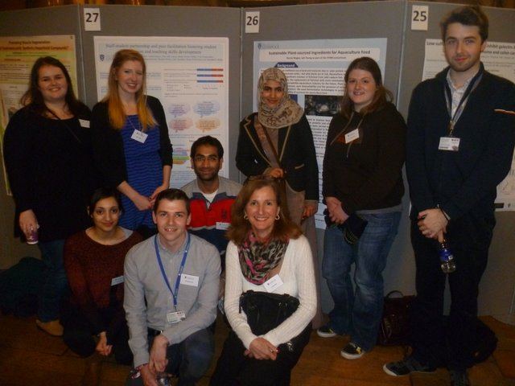
The teacher is of course an artist, but being an artist does not mean that he or she can make the profile, can shape the students. What the educator does in teaching is to make it possible for the students to become themselves. Paulo Freire

