Slide 1
The development of an in-house placement test to improve understanding of future cohorts’ English language needs
Nigel Dixon, Ling Xia, Eoin Jordan
Language Centre

Slide 2
Overview
Background
Test development
Results
Future Directions

Slide 3
Placement testing
Commonly used in language education programmes
Tests aim to place students in a class/level appropriate to their current ability
Considered as a relatively “low stakes” form of assessment
Tests usually need to be quick/convenient to administer
May not involve testing all four skills (reading, writing, listening, speaking)

Slide 4
Placement/entrance testing in the LC
Oxford Online Placement Test (OOPT) has been given to all new Y1 cohorts from 2012-13
Up to 2013-14, was only used to monitor students’ English ability on entry
From 2014-15, has been used to place students into different EAP ability “streams”
Moderately strong correlations with EAP results, but room for improvement

Slide 5
Problems with OOPT
Focuses on general English ability, not ability to complete tasks required in an academic environment
Limited diagnostic information
Only includes “native speaker” British/American voices
Commercial test = needs to be paid for by the LC/university each year

Slide 6
Rationale for an in-house placement test
An in-house test could…
Focus more on the skills needed to be successful in an academic environment
Provide greater diagnostic information
Include a wider variety of voices
Save money/allow for greater investment in staff development

Slide 7
Test development objectives
To create a test that…
Reflects the skills needed to be successful on EAP modules
Provides richer diagnostic data than the OOPT
Uses more than just British/American “native speaker” voices
Is benchmarked to CEFR (Common European Framework of Reference for Languages)
Is time-efficient to administer and grade

Slide 8
Test Development
Project Team
Douglas ‘Mac’ Mackinnon
Gareth Morris
Nigel Dixon
Ling Xia (Angela)
Karen O’Toole
Eoin Jordan
Debra Jones
Joe Lewis

Slide 9
Test Development
Candidate constructs
Reading
Listening
Vocabulary
Grammar
Writing
Critical Thinking
Language Aptitude
Self-assessment
Selection process
Research into published tests and literature
Trialing of sections & question formats
Analysis of Test Trial data for power to discriminate
Finalization of constructs & item format for full pilot test
(separate project)
Notes:
Different question formats trialed for reading / listening / grammar + best discriminators selected; Reasons why CT and LA rejected

Slide 10
Test Development
Constructs & Format for Pilot Test
Reading: two passages, 15 items, MCQs Flesch-Kincaid Grade 10-11; 4K* vocabulary level = 98% coverage Flesch-Kincaid Grade 12-13; 6K* vocabulary level = 98% coverage
Listening: four sections, increasing difficulty 30 items, MCQs & gap fill Sections 1-2: several short passages (campus/classroom situations) Sections 3-4: longer talk / lecturette
Vocabulary: five sections, 64 items, T/F, MCQs & gap fill Identify known words: 2K/4K* levels (Receptive knowledge, breadth) Match words & definitions:3K/5K* (Receptive knowledge, breadth) Match phrases and definitions: 2K/4K* (Receptive knowledge, breadth) Write correct word forms: 1K/2K* (Productive knowledge, depth) Identify synonyms /collocates 1K/2K* (Receptive vocabulary, depth)
*Based on British National Corpus word lists
Notes:
BNC = British National Corpus?

Slide 11
Test Development
Constructs & formats for Pilot Test
Grammar: | five sections, 25 items MCQs, T/F, sentence reformulation, sentence combining
Target structures | Subject-verb agreement Sentence boundaries Active/passive forms | Relative clauses Concession clauses Conditional clauses
Writing: | Discrete point items (MCQs)
Target features | Topic sentences Paragraph unity Paragraph coherence | Conjunctions Sentence transitions
 | Paragraph (write a minimum of 8 sentences)
Assessment criteria | Grammatical range / accuracy; Lexical range / accuracy Paragraph unity; coherence & cohesion
Notes:
The paragraph marking criteria were adjusted after the test specs were prepared. This is the breakdown as finally used, with two criteria weighted 10 pts each.

Slide 12
Test Development
Preparation of Test Specifications
Text length; Text difficulty (structural, lexical)
Timing
Operations required by candidates; item type; scoring
Topic areas; style; communicative function
Input from consultant (Prof. John Read)
Issue of combining diagnostic and placement functions
Preparation of item templates
Further item writing
Review and final version of Pilot Test
Notes:
Analysis on the grounds of….? (

Slide 13
Test Development
Full Pilot Test
Main pilot, Week 3, 2015-16 Semester 1
EAP 015 module students (n = 345)
Vocabulary, Listening, Grammar, Reading (2 hours)
Writing section pilot
Week 4, Semester 1 (40 minutes)
EAP004 module students (n = c.200)
Marking & Data entry
Analysis
Notes:
Week 4 for writing (use or omit)

Slide 14
Results
Year 1 Semester 1 EAP Assessment | Weight
Coursework | 30%
Speaking Test | 30%
Integrated Test (Listening, Reading & Writing) | 40%
Final Module Mark | 100%

Slide 15
In-House Placement Test: Descriptive Statistics
Section | Mean
Vocabulary | 59.45
Listening | 59.90
Grammar | 71.71
Reading | 58.45
Total | 62.38

Slide 16
Results
Overall, the in-house placement test shows a stronger relationship with students’ Semester 1 EAP performance than OOPT.
Correlation between OOPT/In-House Placement Test and Semester 1 EAP Assessment
 | OOPT | In-House Placement Test
S1 Coursework | .456** | .477**
S1 Speaking Test | .453** | .477**
S1 Integrated Test | .544** | .673**
S1 Final Marks | .630** | .708**
Notes
N=345
Correlation is significant at 0.01 level (2 tailed)

Slide 17
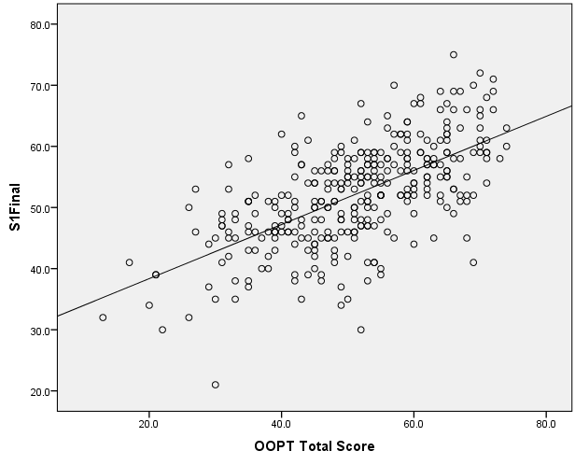
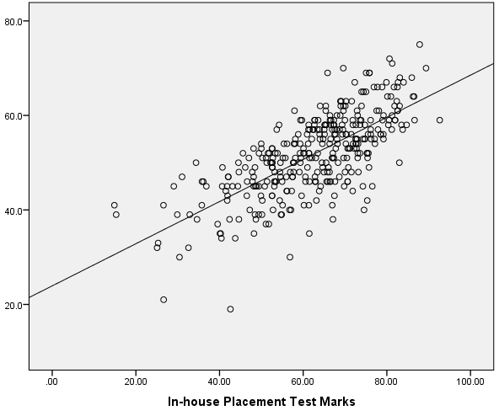
Results
Scatter plot
OOPT Score vs. Semester 1 Final
Scatter plot
In-house Placement Test vs. Semester 1 Final

Slide 18
Constraints of the Results
Sample Representativeness
One stream only
Truncated sample (“High-fliers” taken out)
Timing
OOPT took place first
Potential Self fulfilling prophecy
could favour the OOPT

Slide 19
Future Direction
Analysis of Writing section results
Item and section analysis
Benchmark to CEFR levels
Tailoring and implementation in summer 2016?

Slide 20
References
Carr, N.T. (2011). Designing and Analyzing Language Tests. OUP
Hughes, A. (2003). Testing for Language Teachers, 2nd Ed. Cambridge.
Jordan, E. (n.d.). Randomized Checklist Vocabulary Size Test . Online [Available from] http://www.readingandwritingtools.com/cvst/checklisttest.html
Jordan, E. (n.d.). Reading Mate. Online [Available from] http://www.readingandwritingtools.com/rm/readingmate.html
Notes:
This is something to add.

Slide 21
Acknowledgements
The placement test project was funded by a TDF award (February 2015)
Additional acknowledgements are due to:
LC Tutors who helped prepare test items during Summer 2015:
Andy Snyder, Jackie Hemingway, Way Peng, Anthony Steward, James Dodds, Yimei Xiong, Mac, Hongmei Hu
MA TESOL students who helped with pilot test marking and data entry:
Guhai Jiang, Xuan Gao, Xuerong Wei, Nana Fan
Notes:
Analysis on the grounds of….? (

