Slide 1
Group collaborative Projects:
Technological tools to assess individual contribution

Slide 2
Group Collaborative Projects
According to several recent surveys, the most important skills for tech employers are interpersonal and teamworking skills
Traditional exam based coursework gives students little experience in this crucial area
Group collaborative projects provide a learning experience that more closely matches a professional work environment
However….

Slide 3
Assessment Issues
Students don’t all make equal contributions to groups
Assessing individual contribution to a project is hard
Peer pressure within the group makes this harder
University regulations limit how much of a student’s grade can come from a group evaluation
Does this mean we can’t have group collaborative projects?
No…
We just need to be able to accurately assess individual contribution to group projects

Slide 4
Technological Tools
Project tools can provide fine-grained details about individual student contributions
The tools we’ll discuss today are:
Project planning software
Wiki
Version control software
Online surveys
I’ll also discuss how to combine these into an individual assessment

Slide 5
Project Planning Software
Provides task planning, task breakdown, time estimates, assignments, and completion tracking
Can provide per user reports on tasks assigned and completed
There are numerous options available, depending on which project planning methodology is being used

Slide 6
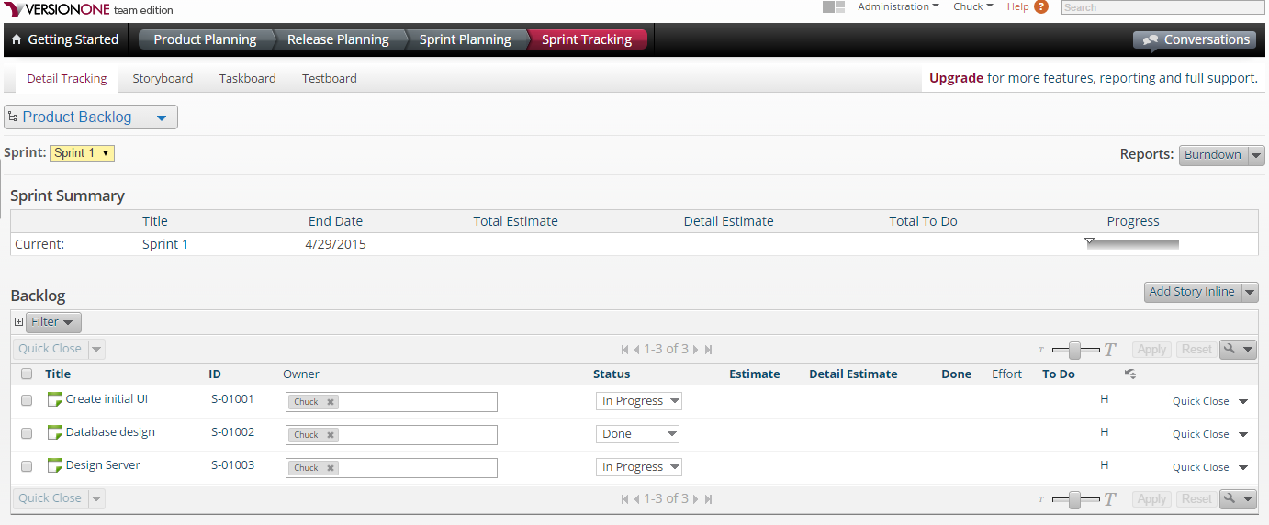
Project Planning Example

Slide 7
Wiki
Provides an editable website for group collaboration
Groups are free to create new pages and links to existing pages
Word like editor allows for text, graphics, and other rich editing features
Suitable for meeting notes, shared project documents, etc
Provides detailed revision history for each page

Slide 8
Wiki Example

Slide 9
Revision Control Systems
Allow students to “check-in” documents to a central repository
Works with any kind of document, including Word files, CAD designs, text files, etc.
Can “merge” revisions made in parallel so that the whole group can work on the same documents
Provides detailed information about modifications including user who modified, change logs between versions, etc
Can be hosted online or on a local server

Slide 10
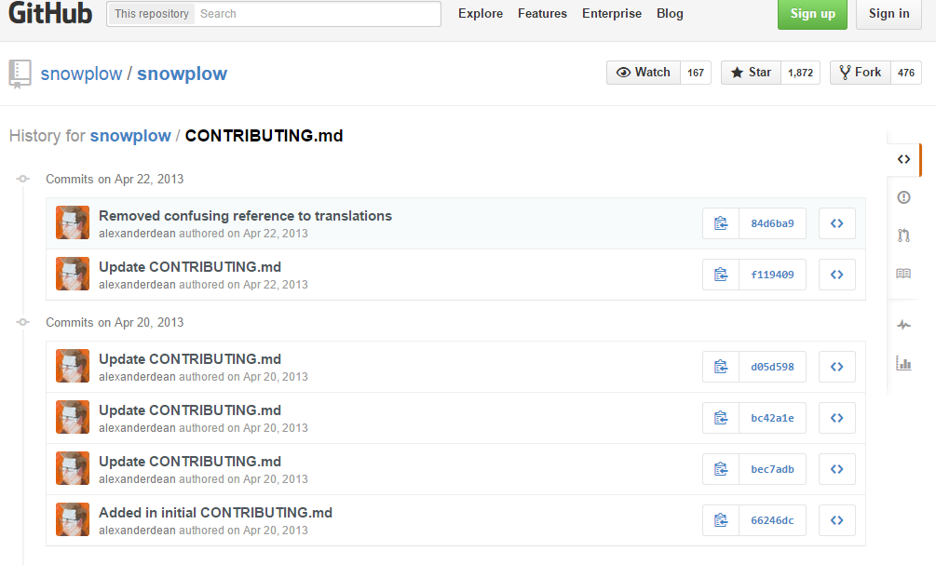
RCS example

Slide 11
Online Peer Surveys
Allow groups to give anonymous feedback on their group
Students can avoid peer pressure by filling out the surveys when their teammates aren’t around
Data needs to be normalized and averaged
Can be externally hosted or a internal web application can be written

Slide 12
Combining These in an Assessment
Each project is assigned a base mark, regardless of number of group members
Individual grade is 20% group/80% individual
Individual mark is calculated as follows:
Each group has a pool of points equal to base mark * 4
Smaller groups have lower base mark, but fewer people to split the pool with
Pool is split based on peer survey results and instructor evaluation of contribution
The sum of the contribution of all students in a group is 1

Slide 13
Example
Group X gets a base project score of 55
Student A gets a 30% contribution rating from his peer review and a 35% contribution rating from the instructor
His mark is 55*0.2 + 0.8*(55*4*0.30*0.5 + 55*4*0.35*0.5) = 68.2
Student B gets a 10% contribution rating from his peer review and a 15% contribution rating from the instructor
His mark is 55*0.2 + 0.8*(55*4*0.10*0.5 + 55*4*0.15*0.5) = 38.5
This assumes the peer assessment and the instructor assessment have the same weight. This doesn’t have to be true.

