Slide 1
The case study of guided exploratory urban planning tours and site visits via a mobile learning application
TDF Project “The City as a Classroom”
Hai-Ning Liang (CSSE, XJTLU)
Sophie Sturup (UPD, XJTLU)
Jessica Sewell (UoV, Urban Env. Planning)
Rebecca Kiddle (VUW, Geography)

Slide 2
Outline
Background
Objectives
Methodology
Progress to date (and results)
Future work

Slide 3
Aims of the project
Two sets of aims:
Teaching
Encourage students to get out and about and experience, observe, discuss urbanity and city planning
Respond to the needs of a large class
field trips common but can be difficult to manage with a large group
cost (man power and economical) can be substantial
Create life-long / independent learners
Develop app theory
Effectiveness of the a map-based app
To supplement theory from typical lectures
Likely use and adoption of the app
Factors that affect this adoption

Slide 4
Student Traits
Functional learners
Prone to memorisation
Want to please and do well
Work long hours (or at least sit for long hours)
Find it difficult to relate theory to practice
Very concerned about employment after university

Slide 5
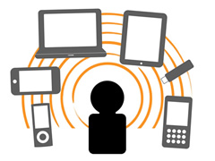
M-learning
Learning assisted by mobile devices (e.g., mobile phones and tablets)
Three phases (Pachler et al., 2000)
Focus on devices
Learning outside of classroom
Mobility of learners

Slide 6
Two challenges
How to design an effective map-based m-learning application
Design of m-learning application is not straightforward
Lack of m-learning apps for guided exploratory tours outside of classroom
What factors would affect their use and adoption
How can we guarantee students will use the app?

Slide 7
Two challenges
How to design an effective map-based m-learning application
Of survey of 70+ students to gather design ideas
The app should have
simple and clear layout (in contrast to current map applications)
enough and specific information about the sites of exploration
simple navigation
pictures, videos and texts stored at the locally on the device (to avoid data downloads)

Slide 8
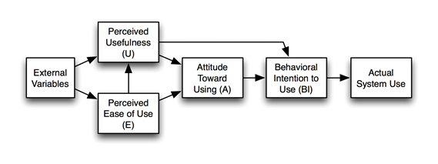
M-learning
How we do know they are effective and adopted?
Use of models / frameworks to predict their adoption
Modified Technology Acceptance Model
Technology Acceptance Model (Davis, 1986)

Slide 9
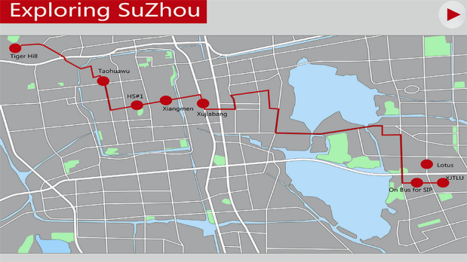
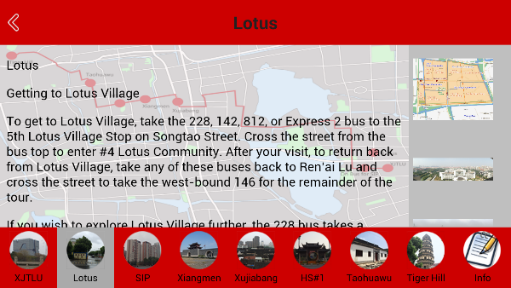
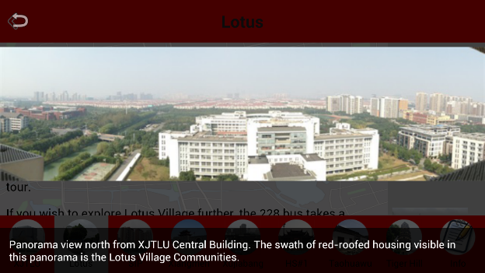
Our learning app
Notes:
The tour is organized into seven parts, each of which focuses on a different area of Suzhou. You can see these on the overall map, and on each page of the app, navigation buttons at the bottom will take you to the main page for each part. (image) For each section of the tour, the app provides text, maps, photographs, and videos to guide users. The text gives users guidance on how to explore the site and what to notice as well as extensive historical and cultural background. The images and videos include maps, images and videos of activities in the site, historical images, and photographs of buildings, landscapes, and details.

Slide 10
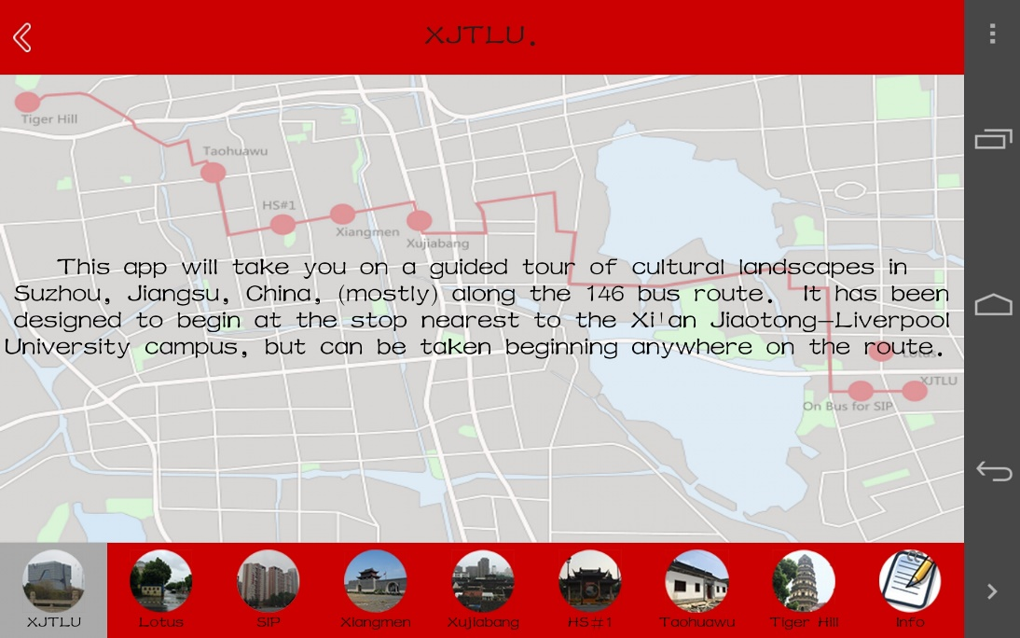
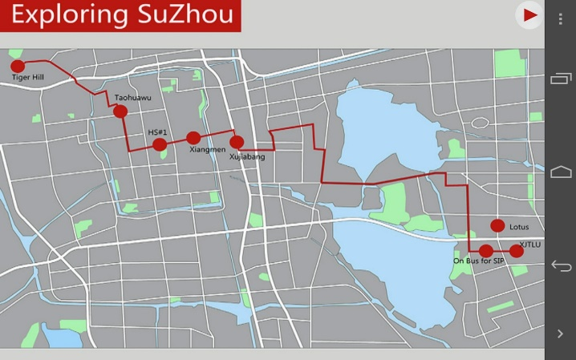
Our learning app
Notes:
The tour is organized into seven parts, each of which focuses on a different area of Suzhou. You can see these on the overall map, and on each page of the app, navigation buttons at the bottom will take you to the main page for each part. (image) For each section of the tour, the app provides text, maps, photographs, and videos to guide users. The text gives users guidance on how to explore the site and what to notice as well as extensive historical and cultural background. The images and videos include maps, images and videos of activities in the site, historical images, and photographs of buildings, landscapes, and details.

Slide 11
Our learning app
Supplement traditional class teaching
Short time use and outside of the class
Balance between
guided tour exploration
students’ schedule and interests
Foster collaborative exploration
Engage, observe and critique the physical environments
Large class size
Students
Chinese background attending an English university environment.

Slide 12
Main behavioral theories
Theory of reasoned action (Fishbein & Ajzen, 1975)
Intention ← attitudes / beliefs
Theory of planned behaviour (Davis, 1989)
TRA + Perceived behaviour control
Self-efficacy theory (Bandura, 1977)
Self-perception of what one is capable of doing
Social cognitive theory (Bandura, 1986)
Actions of others affects our perception
Self-determination theory (Deci & Ryan, 2002)
How an individual’s behaviour is self-motivated, self-determined
Diffusion of innovation theory (Rogers, 2003)
Innovation as an agent of change / adoption
Notes:
You can just mention this briefly and say that the technology acceptance model (TAM) is based on a number of behavior theories. TAM predicts how likely a technology is accepted.

Slide 13
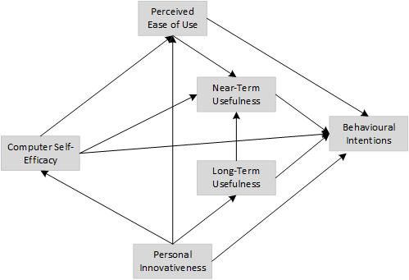
Some predicting models
TAM (Davis, 1989)
Extension of Theory of Reasoned Action
Perceived Ease of Use
Perceived Usefulness
Extend TAM
Perceived Usefulness
Long-term
Short-term
Computer Self-Efficacy
Self-efficacy theory
Personal Innovativeness
Diffusion of innovation theory
Notes:
Perceived ease of use is considered as an important factor which has effect on the adoption of mobile learning. Two types: near-term and long term.
Self-efficacy is the belief that one has the capability to complete a specific task.
Perceived usefulness refers to the degree to the users’ perception of adopting the new technology system
Personal innovativeness is about how likely people are to experiment with new technologies.
Direction of arrows indicates effect from one factor to the other.

Slide 14
Early results
30 students put into groups
Each student had a mobile device
Used the app as a group for 10-20 minutes
Collected feedback from them

Slide 15
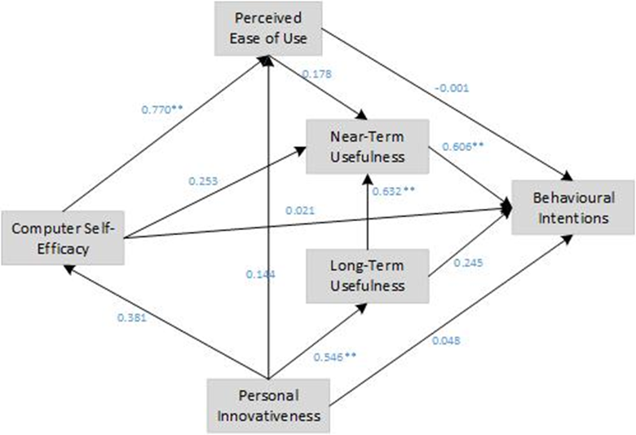
Early results
Perceived Near-Term Usefulness (PNTU)
direct and positive influences on Behavioral Intentions
Perceived Long-Term Usefulness (PLTU)
influence Perceived Short-Term Usefulness
Personal Innovativeness
key for PLTU

Slide 16
Examples from CDE002
Notes:
We have also used the app in CDE002 130 last year, 100 this year.
Students sent off to do the field trip and then report on three sites.
This is the kind of thing that comes back.

Slide 17
Examples from CDE002
Notes:
Also have been collecting information about whether students change their image of the city after going on this kind of exploration.
Have taken maps from students before and after using the app. Will proceed to analyse data – it is with Jessica in Virginia.

Slide 18
Future work
Collect data from intended target group
More time to use the app in actual class and settings
Increase the number of respondents
Explore other factors
Educational compatibility (Lai et al., 2012)
Collaboration (Viberg & Grönlund, 2013)
Facilitating factors (Lai et al., 2012)

Slide 19
Thanks Any Questions or Comments?
Hai-Ning Liang (CSSE, XJTLU)
Sophie Sturup (UPD, XJTLU)
Jessica Sewell (UoV, Urban Env. Planning)
Rebecca Kiddle (VUW, Geography)
We acknowledge funding from XJTLU via TDF.

