Slide 1
Large groups, embedded language support, and blended learning: How an IBSS-LC jointly delivered undergraduate module is responding to current global trends in higher education
Eoin Jordan, Gareth Morris, Tao Bai

Slide 2
Overview
Background
Three global trends relevant to higher education
Massification of higher education
Growth in numbers of non-first-language English speakers studying in English
Growth in mobile internet access
Conclusion
References

Slide 3
Background – XJTLU
XJTLU = transnational English-medium institution
Growing student numbers…
…approximately 3000 new Y1 undergraduate students this year
Most domestic undergraduate students enter based on their overall GaoKao score – no specific English language requirement

Slide 4
Background – MAN001
“Business Essentials”
Y1S1 IBSS-LC jointly delivered module (previously IBSS only)
Taken by all “Business Cluster” students
Over 1000 students enrolled in S1 2015-16

Slide 5
Global Educational Trends
Pressure on educational delivery from the massification of higher education (Altbach, 2007)
Transition from elite → mass → universal higher education (Trow, 2007)
Growth in numbers of non-first-language English speakers studying academic content through English (Altbach, Reisberg, & Rumbley, 2009)
Growth in mobile internet access (Altbach, Reisberg, & Rumbley, 2009)

Slide 6
MAN001 Challenges, Responses and Thinking Forward
For each trend, we have highlighted:
Challenges to MAN001 delivery related to these trends (Challenges)
How MAN001 has responded to these challenges (Responses)
Possible future developments (Thinking Forward)
We hope that the approach taken may be informative for educators who face similar challenges

Slide 7
1. Pressure on educational delivery from the massification of higher education (Challenge)
How to provide an interactive educational experience with:
Over 1000 students registered on MAN001
Limited staffing
IBSS = 1 person FTE (Full Time Equivalent)
LC = 1 person FTE

Slide 8
1. Pressure on educational delivery from the massification of higher education (Response)
Format of delivery:
Lectures: 3 x 2 hour sessions per week / lecture room (IBSS led, 300+ students per lecture)
Large seminars: 8 x 1 hour sessions per week / flat space (LC led, 100+ students per seminar)
Seminars focused mainly on interactive activities in groups of 7-8 students
Use of peer discussion and chatroom feedback during lectures:
Students were asked questions and given time to discuss with peers, before responding to the lecturer
A chatroom was used to elicit responses to questions from the whole lecture theatre, not just the front rows
Blended learning approach - extensive activities on ICE for seminar-/self-study:
Online review quizzes in seminars
Regular peer learning activities (e.g. forum discussions, podcasts, peer assessment, glossary)
Lecture preview videos and quizzes

Slide 9
1. Pressure on educational delivery from the massification of higher education (Response)
Grouping of students:
Students placed in groups of 7-8 students for the whole semester
Commitment to working with that group on tasks
Monitoring of ICE activity:
Email follow-up with students who were not engaging with activities on ICE
Use of anonymous ICE forum for questions:
Students could post any questions they had on an anonymous forum
Teaching staff could answer the questions in view of all students

Slide 10
1. Pressure on educational delivery from the massification of higher education (Thinking Forward)
Student satisfaction with the module was higher than the previous year – advisable to continue approach
Greater structural incentives needed to encourage participation in online/large group activities?
Attendance issues in 2nd half of the semester – symptom of large group sessions?
Provide online lectures?
Lecture time could be focused more on interactive activities (flipped classroom approach)
Increase the amount of video support resources available to students on ICE?
Students appeared to like these

Slide 11
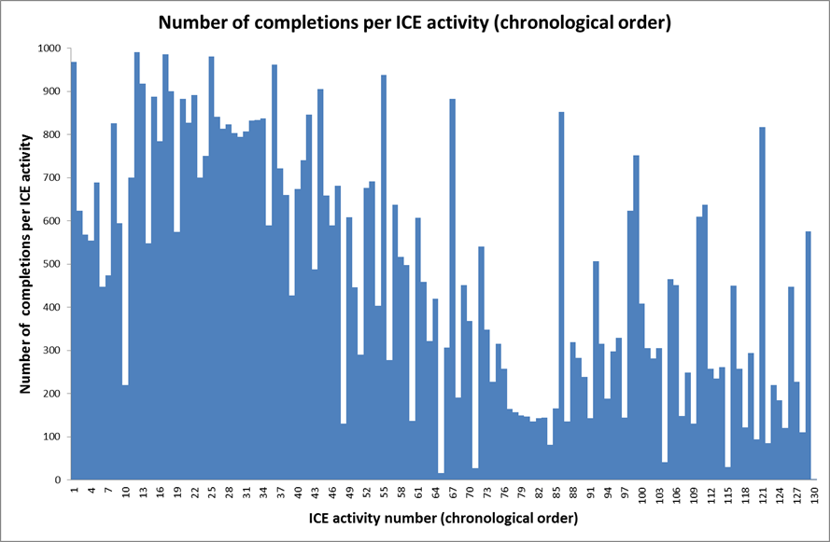

Slide 12
2. Growth in numbers of non-first-language English speakers studying academic content through English (Challenge)
English language delivery, but most students are from mainland China
GaoKao entry – no specific English language entry requirement
Majority at approximately CEFR (Common European Framework of Reference for Languages) B1 level
How to provide English language and study skills support to assist with…
Transition from Chinese/other L1-medium to English medium education
Transition from High School to University education

Slide 13
2. Growth in numbers of non-first-language English speakers studying academic content through English (Response)
Weekly IBSS-led lecture (2 hrs) = content delivery
Weekly LC-led seminar (1 hr) + ICE activities = language and study skills support
Seminars
Cornell note-taking technique
Review of notes from previous lecture (peer comparison/online quizzes)
Preview vocabulary for next lecture (group quizzes/categorization activities)
Introductory discussion tasks on next lecture topic
Skimming and scanning tasks with lecture pre-readings (group-based)
Practice timed writing tasks on previous lecture topics to prepare for final exam (peer checking/generic feedback)

Slide 14
2. Growth in numbers of non-first-language English speakers studying academic content through English (Response)
ICE activities – Pre-lecture
Watch introductory video and do quiz
Add key vocabulary to the module glossary
Read lecture pre-reading (sometimes provided with highlighting of key sections)
Download tailored Cornell-style note-taking sheet
ICE activities – Post-lecture
Post Cornell notes review questions on a forum/answer other students’ questions
Post Cornell notes summaries on a forum/rate other students’ summaries
Record and post group lecture review podcasts/rate other groups’ podcasts
Create practice exam MCQs in groups to review material
Complete peer-assessed online writing practice tasks, based on lecture topics (generic feedback from LC tutors)
Volunteer to join a review podcast with LC tutors (recording shared with the module)

Slide 15
2. Growth in numbers of non-first-language English speakers studying academic content through English (Thinking Forward)
Students reported that LC support was helpful -advisable to continue
Students who completed ICE activities/attended seminars performed better on assessments – advisable to continue
Challenge is how to incentivize non-participating students to participate…
Include participation element to assessment?
Reduce the amount of activities on ICE/label some as optional, so that struggling students are not intimidated
Develop a language/study skills materials bank that can be used in the following year too

Slide 16
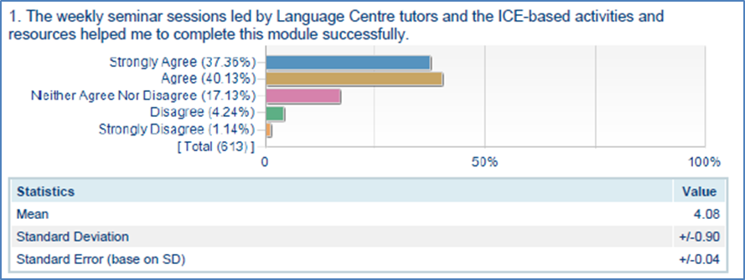

Slide 17
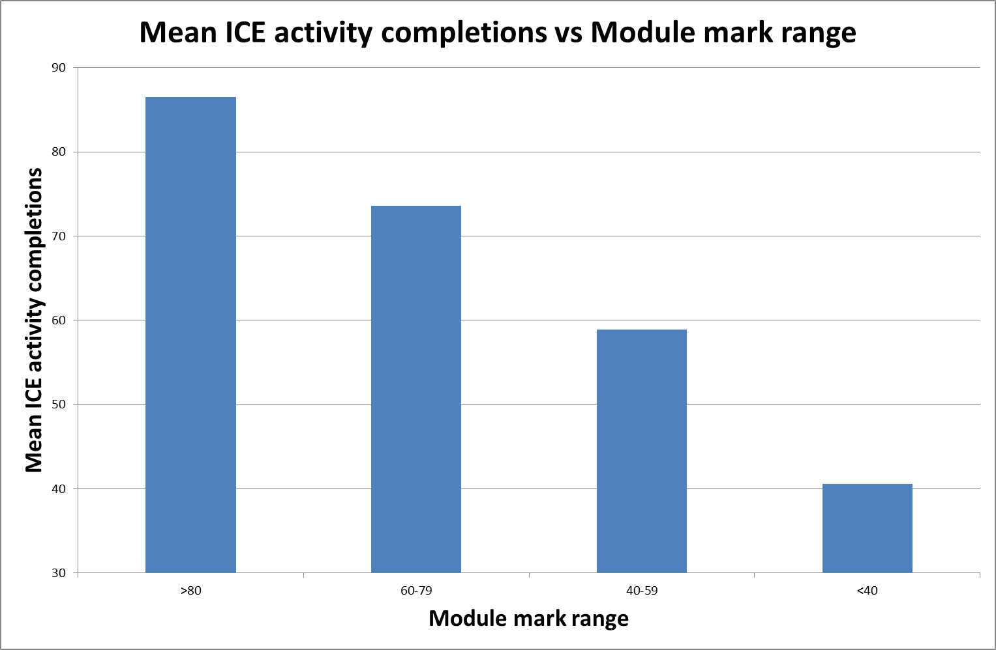

Slide 18
3. Growth in mobile internet access (Challenge)
How to utilize students’ smartphones and internet connectivity to enhance learning on MAN001

Slide 19
3. Growth in mobile internet access (Response)
Use of mobile phones in seminars to…
Answer online quiz questions
Give quick feedback on resources/difficulty of activities or topics
Photograph and share in-class timed writing tasks
Access lecture slides/pre-lecture readings
Look up vocabulary
Use of mobile phones in lectures to…
Contribute to chatroom discussions
Use of mobile phones outside of class to…
Record and listen to podcasts
Watch videos and complete quizzes
Make forum posts
Complete timed-writing peer assessment tasks (write by hand and photograph)

Slide 20
3. Growth in mobile internet access (Thinking Forward)
Continue to make ICE activities as “mobile friendly” as possible
Continue to incorporate mobile-based activities into seminar and lecture classes
However, need to address the distracting influence of technology (Junco, 2012; Ravizza, Hambrick, & Fenn, 2014; Sana, Weston, & Cepeda, 2013)…
E.g. WeChat usage/playing games/watching movies in class
Plan to “zone” seminar classes – when mobile phones are not needed, students are requested to put them out of sight

Slide 21
Conclusion
Looking to the future, there is a continuing need to explore how to:
Provide an interactive learning experience to large student groups with limited resources
Provide language and study skills support to large groups of non-first-language English speakers with limited resources
Harness the educational potential of mobile internet connectivity, while mitigating its potentially distracting effects

Slide 22
Reference List
Altbach, P. G. (2007). Globalization and the university: Realities in an unequal world. In J. J. F. Forest & P. G. Altbach (Eds.), International handbook of higher education (pp. 121–139). Springer.
Altbach, P. G., Reisberg, L., & Rumbley, L. E. (2009). Trends in global higher education: Tracking an academic revolution. Paris: United Nations Educational, Scientific and Cultural Organization. Retrieved from http://unesdoc.unesco.org/images/0018/001832/183219e.pdf
Junco, R. (2012). In-class multitasking and academic performance. Computers in Human Behavior, 28(6), 2236–2243. doi:10.1016/j.chb.2012.06.031
Ravizza, S. M., Hambrick, D. Z., & Fenn, K. M. (2014). Non-academic internet use in the classroom is negatively related to classroom learning regardless of intellectual ability. Computers and Education, 78, 109–114. doi:10.1016/j.compedu.2014.05.007
Sana, F., Weston, T., & Cepeda, N. J. (2013). Laptop multitasking hinders classroom learning for both users and nearby peers. Computers and Education, 62, 24–31. doi:10.1016/j.compedu.2012.10.003
Trow, M. (2007). Reflection on the transition from elite to mass to universal access: Forms and phases of higher education in modern societies since WWII. In International handbook of higher education Vol. 18 (pp. 243–280). doi:10.1007/978-1-4020-4012-2

